Slide 1
COVID-19 Town Hall Webinar
April 16, 2020

Slide 2
Housekeeping
For this broadcast, your camera and microphone have been disabled. We encourage you to interact with other participants in the Chat, located at the bottom of the broadcast window.
Submit questions to the panel using the Q&A box at the bottom of the broadcast window, not through the Chat.
If you have technical issues, please close your browser and restart the webinar – or perhaps move closer to your router.
We are recording this broadcast today and will be adding the full video to the ASA website to view on demand or share with your colleagues within the next 24-48 hours.
asahq.org | apsf.org

Slide 3
Disclaimer
As a reminder, the items we discuss today are provided for informational purposes only and do not constitute medical or legal advice. As always, you should consult with your own medical and legal counsel.

Slide 4
Learning Objectives
At the end of this event, learners will be able to:
Describe ICU care for a patient with hypercoagulation
Identify techniques to treating respiratory failure
Discuss precautions for OB care during the COVID-19 crisis
www.asahq.org/townhalls

Slide 5
Welcome, Anesthesia Community
Anesthesia Care Team: Anesthesiologists, Anesthesiologist Assistants, Nurse Anesthetists, Anesthesia Techs, Anesthesia Administrators and Executives
American Society of Anesthesiologists
Anesthesia Patient Safety Foundation
Society of Critical Care Anesthesiologists
Society of Critical Care Medicine
Hospital and health system leaders

Slide 6
Anesthesia Machines as ICU Ventilators and ICU Patient Management Training
New and frequently updated guidance on converting anesthesia gas machines and fresh gas flows. Detailed instruction and a quick reference guide available online and in PDF form. Created in collaboration with ASA/APSF.
www.asahq.org/ventilators
Additional updated resources and training for managing COVID patients in the critical care setting. Created in collaboration with ASA/APSF/SOCCA/SCCM.
www.asahq.org/CAESAR

Slide 7
Anesthesia Machines as ICU Ventilators Hotline
Help increase the availability of ventilators for the ICU setting
Get instruction and guidance to use anesthesia machines as ventilators
Call agents available to provide web-based resources 24/7
Physician experts on call daily from 6 a.m. – 10 p.m. ET
1-800-224-1001

Slide 8

Special Hotel Deals and Discounts
Member-exclusive offers and discounts from American Express, Hilton, Marriott and Hyatt.
www.asahq.org/hotel-discounts

Slide 9
Economic Relief and Drug Shortages
Economic Relief
  $30 billion in grants was released to physician practices
  Additional loans from Small Business Administration issued
  Continued advocacy (See "Late-Breaking Developments" on ASA website https://www.asahq.org/in-the-spotlight/coronavirus-covid-19-information)
Addressing Drug Shortages
  FDA approved 2020 aggregate production quota increase of 15% for certain opioids
  Asked FDA to appropriately extend expiration dates
  Partnering with ASHP on guidance to avoid unnecessary drug wastage

Slide 10
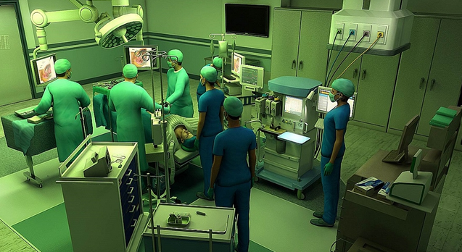
Online Education Free to AA Student Members
Bridge the gap in planned clinical learning with free online education
Anesthesiologist Assistant programs can enroll their students, if they are ASA members, in free online education courses through June 30, including:
  Anesthesia SimSTAT - Powerful, realistic online simulation training
  ACE-CAA
  Plus 19 Patient Safety modules – always free!
  Program leaders please contact Sarah Braun:
  s.braun@asahq.org

Slide 11
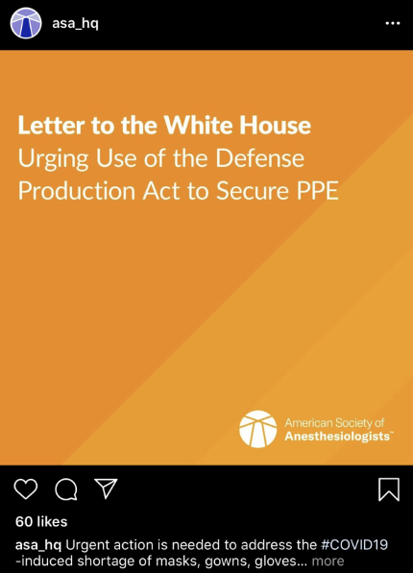
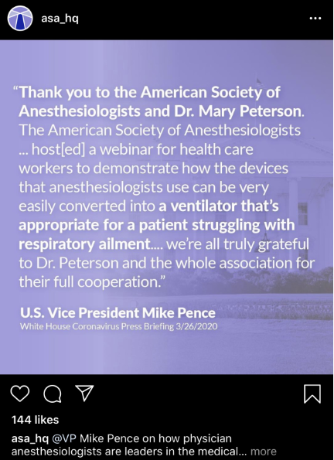
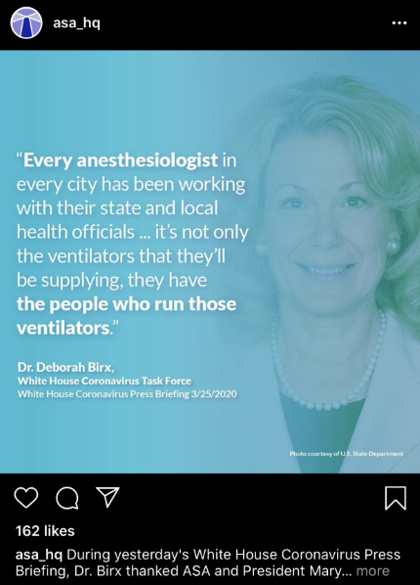
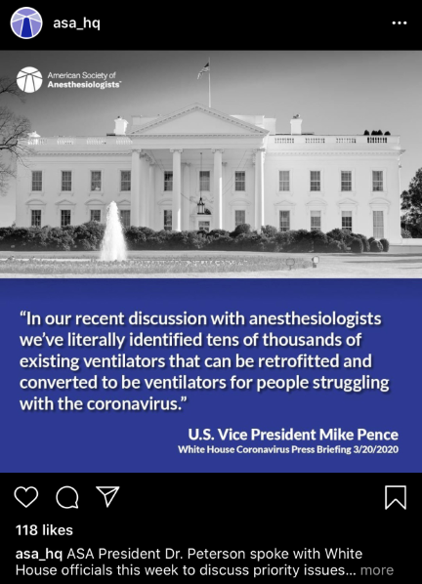

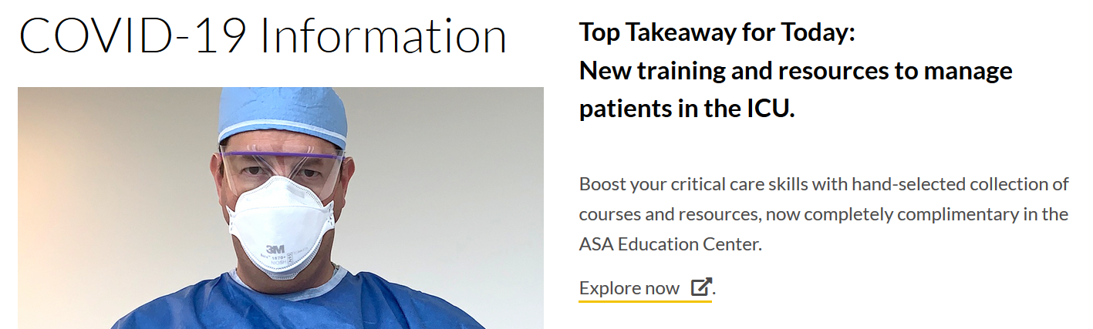
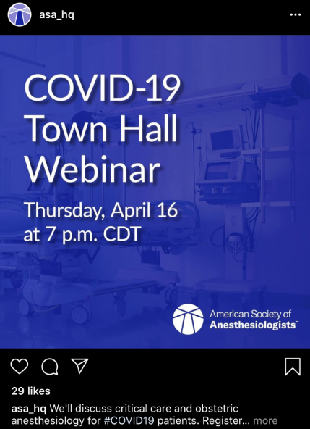
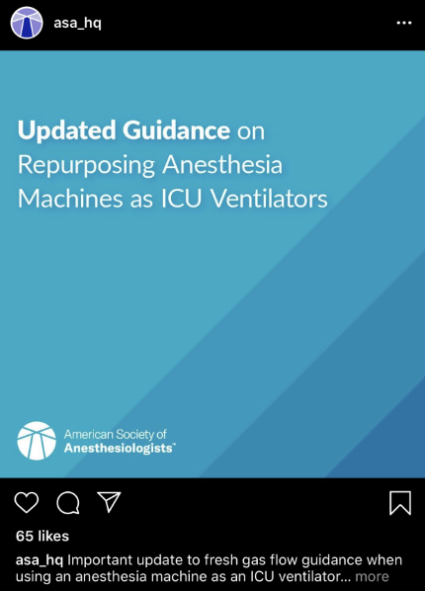
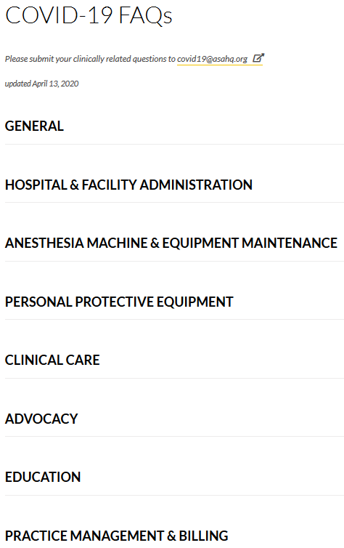
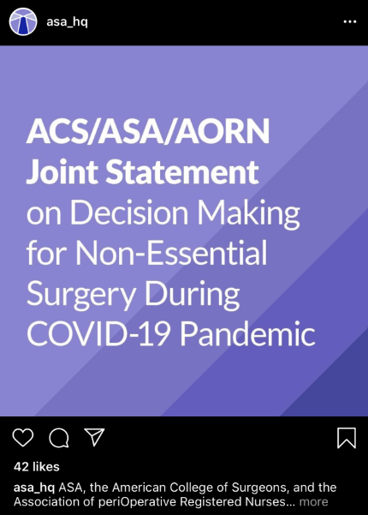
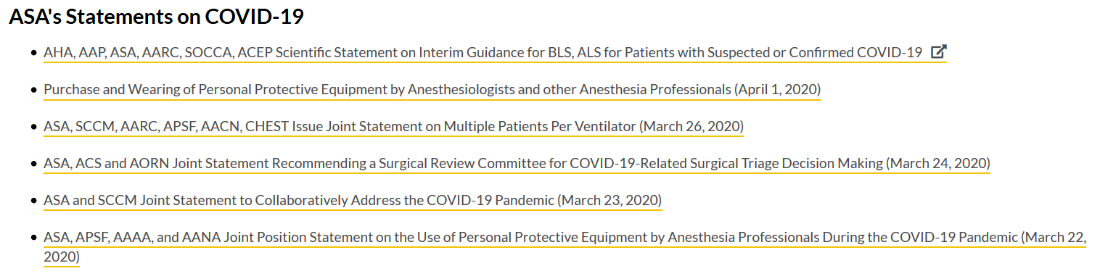
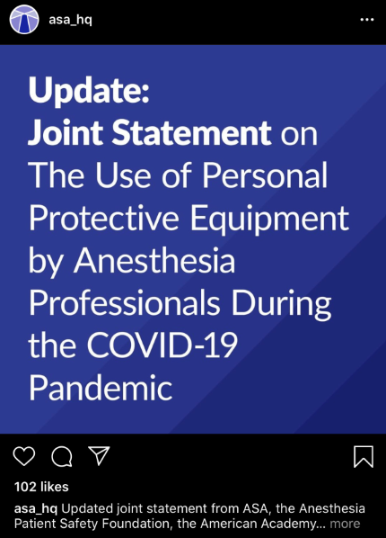



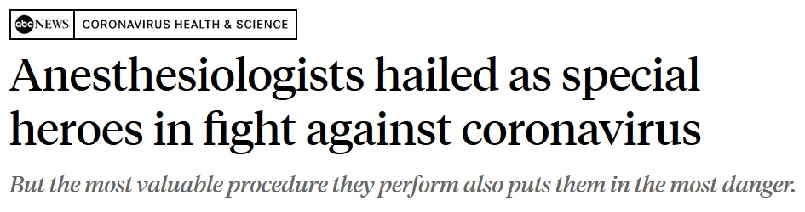
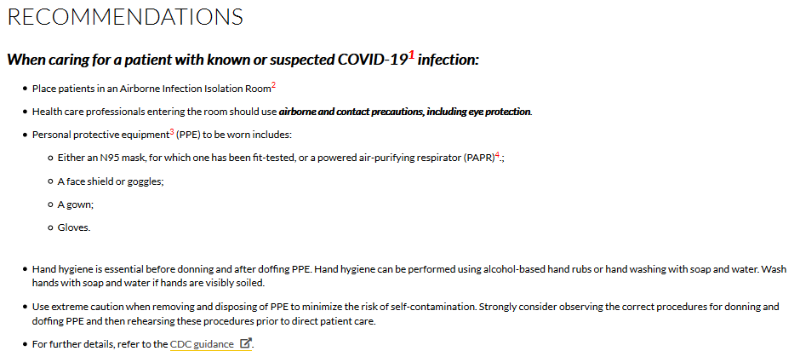
Incredible Progress – And More to Come

Slide 12
Share Your Stories
How has COVID-19 changed your daily life and practice?
What poignant or uplifting patient care situations have you experienced?
How are you leading as an anesthesiologist?
www.asahq.org/covidstories

Slide 13

Panel Participants

Slide 14

COVID Vent Management
Mark Caridi-Scheible, M.D.
Emory Critical Care Center, Atlanta, GA

Slide 15
Introduction & Objectives
Anesthesiology Critical Care Attending
Emory University Hospital
Team member, Best Practices Committee for Emory system
Today:
  Ventilation and oxygenation strategies in COVID for intubated patient only
Not today:
  Oxygenation strategies pre-intubation
  Timing of intubation

Slide 16
The Disease
COVID waits for no one
Slow, extended plateaus with rapid, unpredictable transitions over hours
  Prodrome
  Silent hypoxia (O2 2-8L, comfortable, floor phase)
    Tachypnea may be early warning
  Struggling (O2 10-15L, increasingly tachypneic +/- anxiety&SOB, worse CXR)
    Increasing presentation, some recover from this phase but fewer, must be in ICU
  Respiratory Failure (O2 > 15L)
    HHFNC or Intubation
  Recovery or MOSF/sudden death
Encephalopathy, atypical hypoxic failure (normal compliance, not really ARDS), mild AHI, variable but common AKI, hypercoagulability, difficult & occult secretions)
Sudden death (hyperinflammatory/myocarditis picture), hypercoagulability

Slide 17
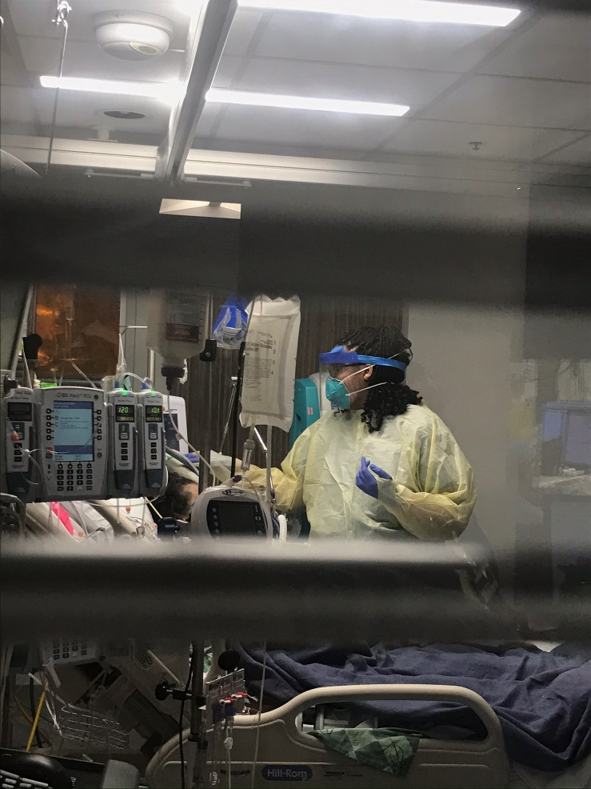
Patients & Statistics
At single hospital 60 known positive patients that were critically ill
  Wide age range but relatively few < 40 yo
  Variety of co-morbidities including HTN, asthma, sarcoid, transplant, myxedema, CAD, morbid obesity, HF
Approx 90-95% required intubation
  Relatively few proning, paralysis, flolan
  Intubation duration range 7 days to 3 weeks
  3 VV-ECMO
  Most getting extubated, about 5% heading to trach
20% mortality for ICU admits
  Most consistent with co-morbid disease – esp immunosuppressed, advanced age
  Several deaths that seem to have been associated with cardiac or PE
  As weeks go on, mortality rising due to:
    Increasing number presenting sicker (self-isolated) and requiring intubation immediately
    Accordingly increased number of vent days per patient
    Superinfection, PE, CVA
Good supportive care remains only known effective therapy

Slide 18
Early Experiences
Approached like ARDS
  PEEP (high), paralysis, proning, epoprostenol
  High MAP (APRV, IRV)
  Low volumes
But noticed:
  Compliance usually preserved (but not always)
  Evidence of overdistention
    compliance worsened as peep pushed to high end of vital capacity
    Several pneumothoraces
    Hemodynamic instability
  Dyssynchrony more pronounced
  Highly variable response to proning, peep, paralysis, inhaled dilators

Slide 19
COVID Lung
Some conflicting recommendations, but good overall explanations:
ESICM Webinar: How to ventilate in COVID-19
  April 2, 2020, Wong
  https://www.esicm.org/blog/?p=2744
Gattinoni et al. COVID-19 pneumonia: different respiratory treatment for different phenotypes?
  https://www.esicm.org/wp-content/uploads/2020/04/684_author-proof.pdf

Slide 20
COVID Lung – 2 Phenotypes
Normal Compliance
  Gattinoni Type “L”
  V/Q mismatch 2/2 dysregulated hypoxic vasoconstriction & inflammation
  Relatively low PAP
  Low lung weight
  Low recruitability
Low Compliance
  Gattinoni Type “H”
  V/Q mismatch 2/2 shunt through non-aerated consolidations
  Increased PAP
  Increased lung weight
  High recruitability

Slide 21
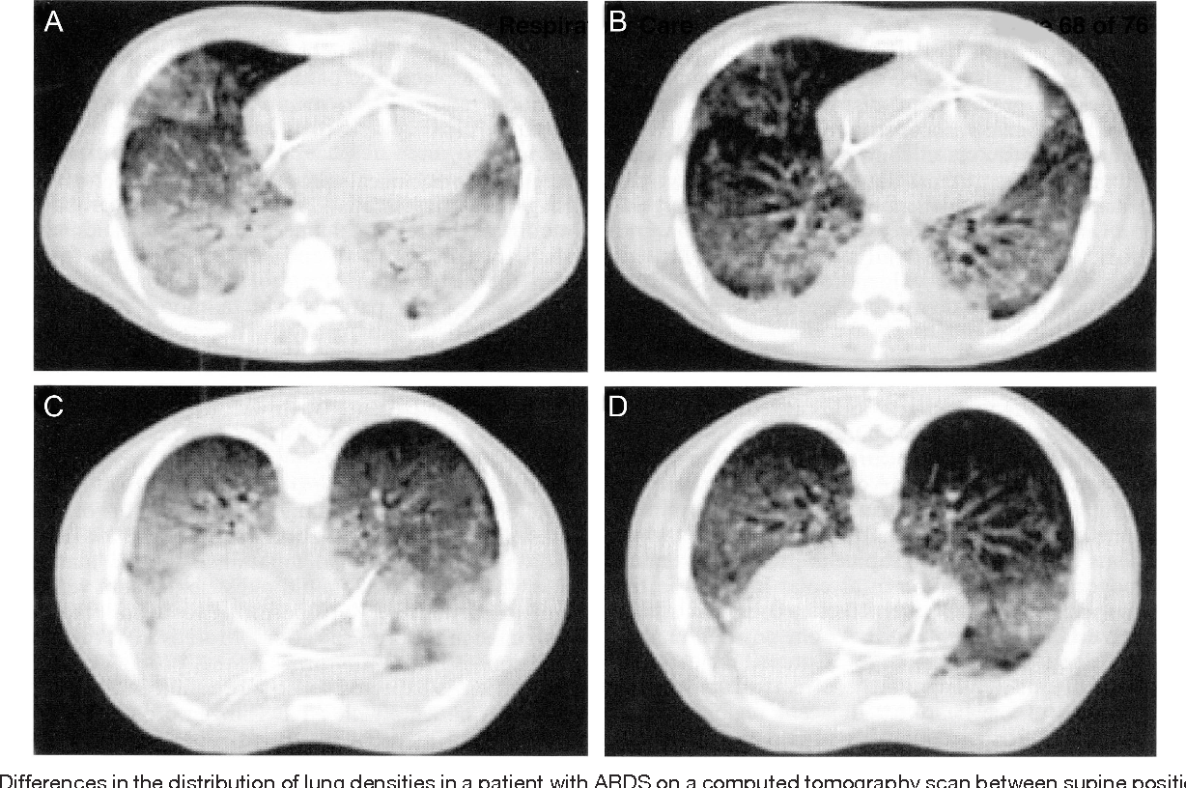
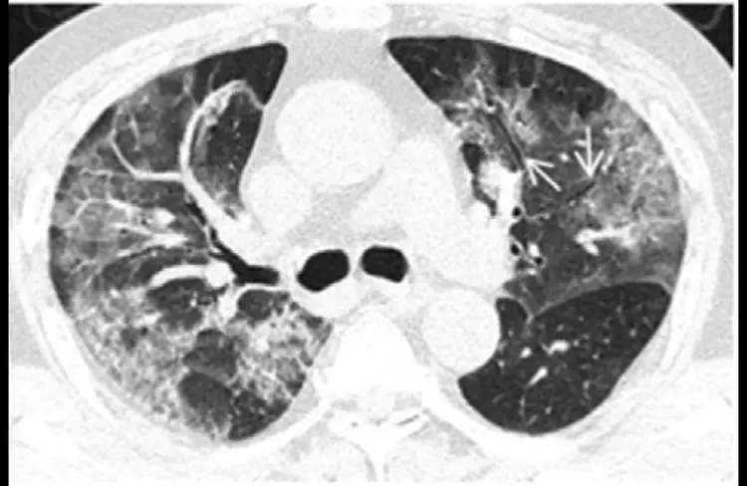
ARDS Lung vs. Non-ARDS COVID Lung
A Comprehensive Review of Prone Position in ARDS.
Richard H Kallet

Slide 22
Ventilation Strategy – ARDS Phenotype
Low compliance
Usual ARDS Management
  PEEP Ladder
  APRV, IRV
  Low tidal volumes
  Paralysis (cognizant of shortages)
  Proning +/- Paralysis
  Inhaled pulmonary vasodilators (cognizant of shortages)
Sedation/paralysis as required for synchrony & compliance
Avoid Miduri steroids as long as able

Slide 23
Vent Strategy – High Compliance Phenotype
Normal compliance
Minimize PEEP
  Keep to 8-12 as able, wean first as able
  Favor increasing FiO2 first
  Recruitment maneuvers as needed without PEEP increases
  If able, use optimal peep methods (P0.1, Opening P, esoph manometry, etc)
Allow normal tidal volumes
  Mindful of P-SILI

Slide 24
Vent Strategy – High Compliance Phenotype
Normal compliance
Inhaled pulmonary vasodilators
  May be more effective in this group
Proning
  May not be as effective in this group
  Consider not being first line tx given number of people required/safety & sedation requirements
Paralysis
  Does not seem to be helpful except as rescue for dyssynchrony (bolus dose)
No role for steroids
Mode discussion requires some context

Slide 25
Dyssynchrony in High Compliance Group
Multifactorial
  Profound encephalopathy
  Air hunger due to inflammation
  Coughing and tenacious secretions
  Mode inconsistent with phenotype
Signs
  High peak pressures
  Belly breathing
  High negative pressures as evidenced by CVP or other hemodynamic swings
  Agitation
  Sudden desaturations
  Coughing
  Tachypnea

Slide 26
Dyssynchrony
What the patients want
  High flow rates, short I-time
  Variable tidal volumes
  High tidal volumes
  Mobilize mucous
  High minute ventilation (appropriately or not)
Synchrony complicated by
  Patient-Self Induced Ventilatory Injury (P-SILI)
    High negative pressures and pulmonary edema
    Volutrauma
  Sedation & Paralysis
    Desire to minimize d/t downstream effects and shortages
  Provider comfort and skill adjusting vent

Slide 27
Mode and Synchrony – Staged Approach
Acute decompensation: bolus paralytic, get control
Secretions: good pulmonary hygiene regimen for everyone
(HTS, avoid anticholinergics, chest PT as needed)
Vent mode:
  PCV likely best, monitor compliance
  Allow normal tidal volumes
  Avoid fixed flow (VC)
  PC-VG modes may work but may oscillate
  Adjust I-time to match desired exhalation time
If remains dyssynchronous, high negative pressures or high tidal volumes
  Increase level of sedation judiciously
  If already unresponsive (RASS -4 or 5) and appears reflex driven, consider bolus paralysis
  If requires multiple bolus paralysis despite all else, then consider continuous
  Keep trying tho to return to above

Slide 28
Non-vent considerations, any phenotype
Micro or macrovascular thrombi
  May be contributing to both hypoxia and hypercarbia
Consider addressing with anti-coagulation (next presentation)

Slide 29
Extubation
Pulmonary mechanics and gas exchange resolve before encephalopathy
  Potentially high reintubation rate if too aggressive extubation
Deconditioning is rapid
Plan on extubation to HHFNC or NRB for period of time

Slide 30
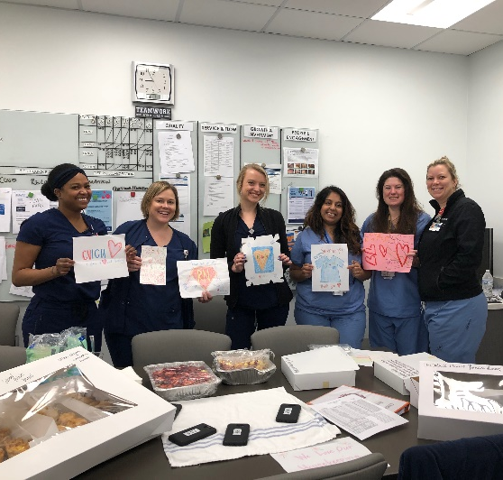
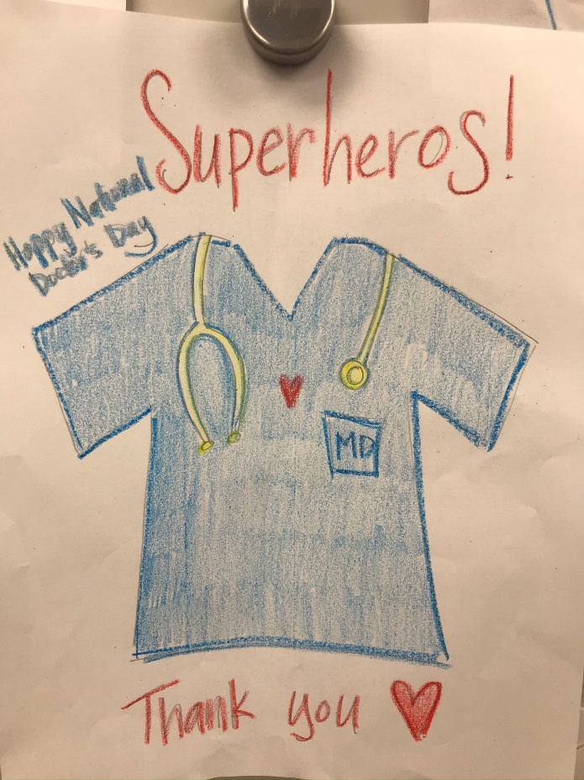
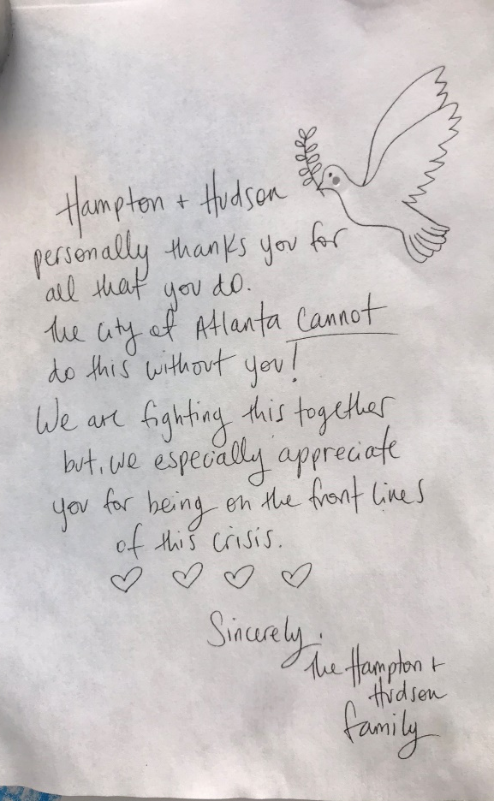
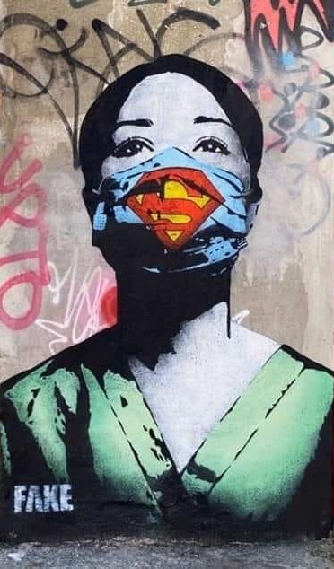
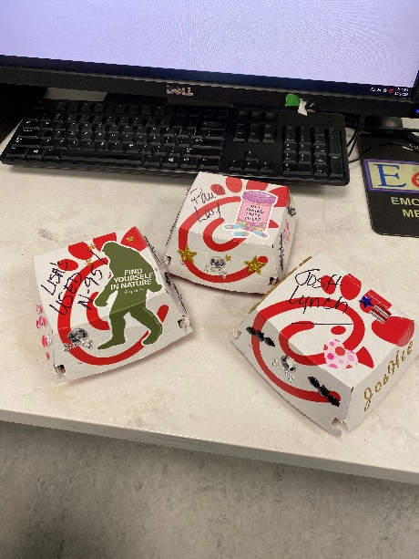
Final thoughts
Supportive care #1 tx
It will be unfamiliar territory
It continues to be worth it
Photos by Christina Creel-Bulos, M.D., Critical Care Fellow

Slide 31
Anticoagulation and Monitoring
Justin N. Tawil, M.D., FASA
Assistant Professor of Cardiothoracic and Critical Care Anesthesiology, Medical College of Wisconsin, Milwaukee, WI

Slide 32
Disclosures
No conflicts of interest
My direct care of COVID patients has been those on ECMO

Slide 33
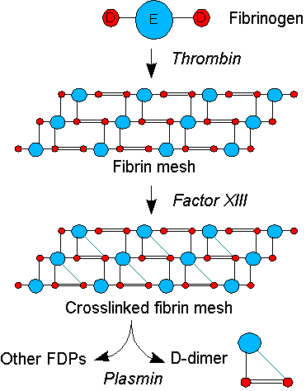
Summary
Known COVID-19 specific hematology issues
Review common anticoagulants
Coagulation and anticoagulant monitoring pitfalls
Treatment recommendations
What my team is doing
Conclusions
Google Image

Slide 34
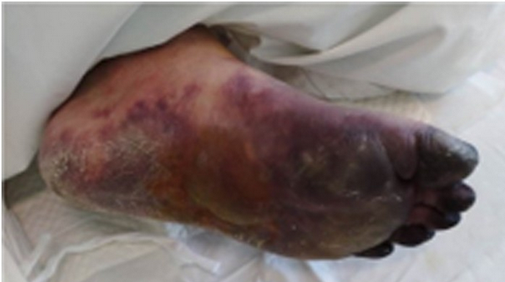
Coronavirus Coagulopathy
Septic inflammation and DIC common SARS and MERS†
  Acute Phase Reactants: fibrinogen, factor VIII, thrombocytosis
  Disseminated Intravascular Coagulation (DIC): clotting and lysing
    Low fibrinogen & platelets
    Elevated PT/PTT/d-dimer
Coagulopathy is common in sick COVID-19 patients
  50% of non-survivors; 7% of survivors‡
  DIC: 71% non-survivors; 0.4% of survivors∆
Clotted fingers/toes without high dose pressors
‡Zhou F, et al. "Clinical course and risk factors for mortality of adult inpatients with COVID-19 in Wuhan, China: a retrospective cohort study." The Lancet (2020).
∆Wang D, Hu B, et al. Clinical characteristics of 138 hospitalized patients with 2019 novel coronavirus–infected pneumonia in Wuhan, China. Jama. 2020 Feb 7.
†Giannis D, Ziogas IA, Giannic P. Coagulation disorders in coronavirus infected patients: COVID-19, SARS-CoV-1, MERS-CoV and lessons from the past. J Clin Virology.

Slide 35
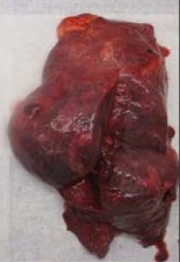
COVID-19 Hemorrhagic Phenotype
Autopsy reports of pulmonary hemorrhage confirmed in the US
Thrombocytopenia & low fibrinogen
  Associated with poor outcomes
  Late stage of DIC?
Overt bleeding rates unknown
Image from: Fox SE, et al. Pulmonary and Cardiac Pathology in COVID-19: The First Autopsy Series from New Orleans
medRxiv 2020.04.06.20050575​

Slide 36
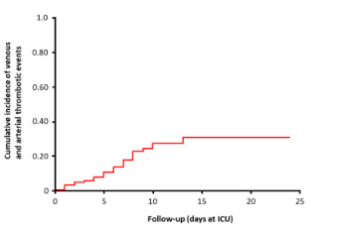
COVID-19 Thrombophilic Phenotype
Limited autopsy data vary thrombosis and microthrombi
Common to have dialysis, CVL & ECMO clotting
Case reports of extensive thrombosis
Case series of PE/DVT
Chinese “studies” questionable and often no ppx
Rates of thrombosis unknown
  Dutch ICU study shows 31% composite thrombosis
    On ppx
    DVT/PE ~27%
    Stroke ~ 3%
Klok FA, et al. Incidence of thrombotic complications in critically ill ICU patients with COVID-19. Thrombosis Research (2020).

Slide 37
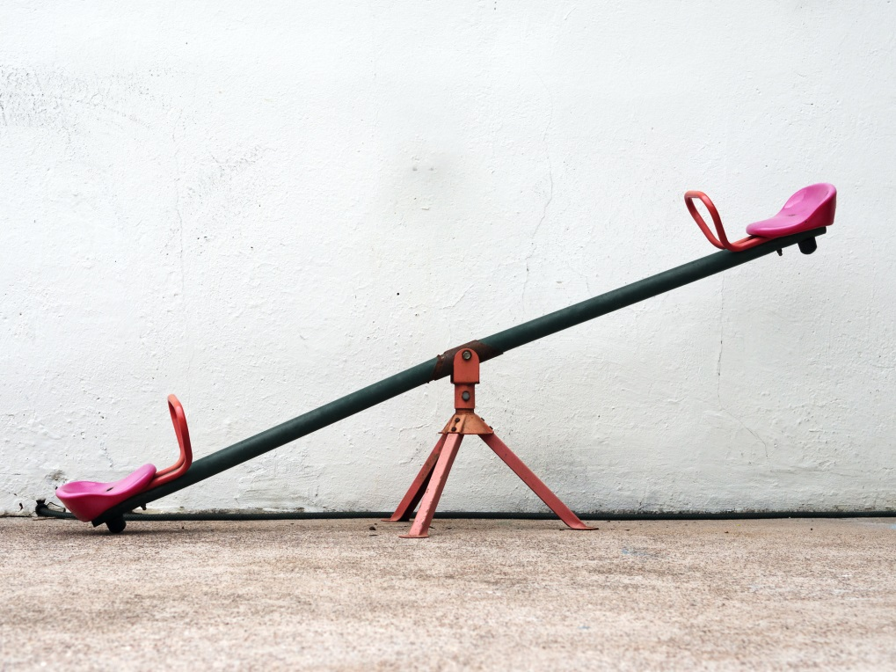
Risks of Anticoagulation
Bleeding (2-5%)
  ICH
  Pulmonary
  Procedure related (frequent line placement)
  Retroperitoneum
  Falls & Foley trauma
Heparin Induced Thrombocytopenia
  UFH ~ 1%
  LMWH ~ 0.5%
Bleeding
Clotting
Anticoagulation

Slide 38
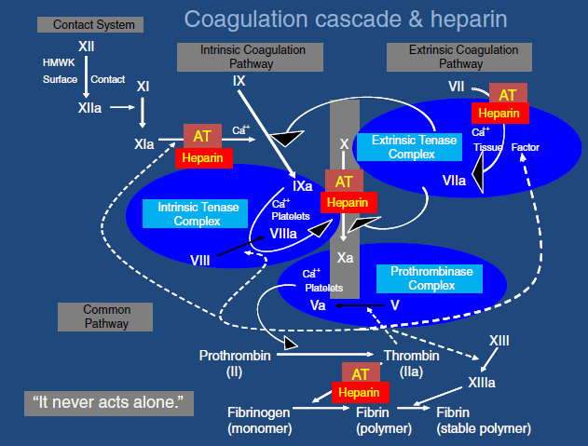
Unfractionated Heparin (UFH)
Facilitates Anti-Thrombin (AT)
  Increases AT function 1000x
  Functions in plasma, not clots
Clearance is temperature, dose and renal dependent
Reversal agent protamine
Unfractionated Heparin monitoring is complex
Annich GM. Extracorporeal life support: the precarious balance of Hemostasis J Thromb Haemost. 2015 Jun;13 Suppl 1:S336-42
Dosing
PPX: 5,000 – 7,500 units q 8-12h
Tx: 4-30 units/kg/hr

Slide 39

Low Molecular Weight Heparin (LMWH)
Enoxaparin & Dalteparin
Primarily blocks Xa (AT)
Benefits: faster to tx, no infusion, PTT and anti-Xa more reliable
Comparable bleeding risk to UFH
  Reduce dosing for GFR < 30
  Increase dosing in BMI > 40
Reversal with protamine partially effective
Dosing (adjust for GFR and obesity)
PPX:
  Enoxaparin 30-40mg q 24h
  Dalteparin 2,500 – 5000 Units/24h
Tx:
  Enoxaparin 1mg/kg q 12h
  Dalteparin 120 units/kg q 12h

Slide 40
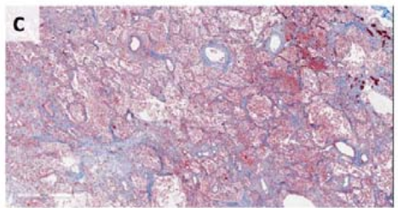
ARDS and Anticoagulation
Pre-COVID Tissue Plasminogen Activator (TPA) in ARDS increases PaO2∏
Beth Israel COVID TPA trial
  25mg (over 2 hours) followed by 25mg /
  22 hours
  Responders continued on heparin
COVID Hope Trial
  Inhaled Heparin + NAC
Blue perialveolar fibrin deposits
Image from : Fox SE, et al. Pulmonary and Cardiac Pathology in Covid-19: The First Autopsy Series from New Orleans medRxiv 2020.04.06.20050575
∏: Hardaway RM, Harke H, Williams CH. Fibrinolytic agents: a new approach to the treatment of adult respiratory distress syndrome. Adv Ther. 1994;11:43–51.

Slide 41
Other Agents
Direct Thrombin Inhibitors
  Bivalirudin & Argatroban
  HIT and heparin resistance
  PTT dependent monitoring
  Inhibit IIa
  No reversal agents
  Act in plasma and clot
  Expensive ($400-4000 per day)
Direct Oral AntiCoagulants (DOAC)
  Direct Xa inhibitors
  Minimal monitoring needed
  Can be used for ppx or tx
  Apixaban reversal
  Preferred over coumadin

Slide 42
Coagulation and Monitoring
Activated Clotting Time (ACT)
  ACT is poorly associated with heparin dosing, bleeding, clotting
  All ACT is not the same
    Many devices (ACT, ACT Plus, ACT Hemacron …)
    “Normal” range is different with each device
  Confounders: hemodilution, anemia, factor deficiency, hypothermia, low fibrinogen, platelet function and number, d-dimer
PTT and Anti-Xa testing are preferred to ACT

Slide 43
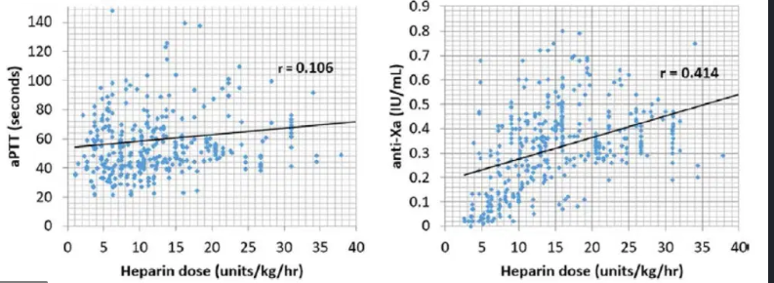
Anticoagulation Monitoring in COVID
TLDR: Anti-Xa heparin monitoring is better. Non-heparin PTT confounds in COVID are strong and variable.
Partial Thromboplastin Time (PTT)
Intrinsic pathway (VIII,IX,X,XI,XII)
No standard lab technique
  300+ protocols
  Goal 1.5-2.5 x normal/baseline
  No standard control
Weak correlation to heparin dosing
Reduced PTT
  High levels of factor VIII and fibrinogen
Prolonged PTT
  Anemia/polycythemia, low fibrinogen,
  d-dimer, CRP, liver dysfunction, low factor levels, low or dysfunctional platelets, lupus, tube filling errors, delayed processing, diurnal changes, sample transport temp…
Anti-X
Inhibition of Xa
  Pure heparin/AT test
Gold standard (expensive, availability)
Goal 0.3-0.7 IU
Confounds LOWER reported values:
  Triglycerides> 350mg/dl, Total bilirubin > 6 mg/dl, hemolysis, post tPA
  Cause OVER dosing of heparin
No effect from fibrinogen & platelets
Arnouk S, et al. Evaluation of anti-Xa and activated partial thromboplastin time monitoring of heparin in adult patients receiving extracorporeal membrane oxygenation support. ASAIO Journal 66.3 (2020): 300-6.​

Slide 44



Society COVID Recommendations
Limited data to alter generic ICU ppx
ASA Critical Care Committee Member Experience
  Full range of tx
International Society on Thrombosis and Haemostasis
  All COVID without contraindications: ppx LMWH
American Society of Hematology
  Monitor for DIC
  LMWH ppx hospitalized COVID (unless low plt/ fibrinogen)
    ***Dose adjustment for obesity and renal failure***
  Full anticoagulation only for documented thrombus

Slide 45

What my team is doing now
Non-surgical patients
Floor: ppx LMWH daily
ICU: ppx LMWH q 12h
D-dimer > 5 mcg/ml or line issues
  Consider therapeutic case by case
  Anti-Xa q 6-24h
    PTT & TEG PRN or daily
ECMO
No changes to antiplatelet
  Aspirin 81mg daily
  Hold if plts <50 and TEG MA <50
Previously targeting Xa = 0.21-0.35
COVID patients are clotting oxygenators
  UFH Xa 0.3 – 0.7
  Daily TEG R-time (10-16s)

Slide 46
Take home points
Inflammatory surge is variably associated with hypercoagulable state
Understand your lab test & patient as you interpret results
  Inflammation activates Tissue Factor and Compliment pathways
  Anticoagulation initiation, drugs & goals should be patient specific
  Anti-Xa based monitoring more accurately reflects heparin effect in COVID
    Caution with dysfunctional liver or platelets
  PTT guided anticoagulation is problematic in COVID
    Increased with elevated d-dimer, DIC and CRP
    Decreased with high levels of factor VIII, and high fibrinogen
Hematologic societies remain skeptical of empiric anticoagulation

Slide 47

Thank You
Mary Dale Peterson, M.D. & George Williams, M.D.
ASA CCM Committee
Lisa Baumann Kreuziger M.D. and Joel Feih, PharmD
All of you fighting the good fight

Slide 48
References
Arnouk S, et al. Evaluation of anti-Xa and activated partial thromboplastin time monitoring of heparin in adult patients receiving extracorporeal membrane oxygenation support. ASAIO Journal 66.3 (2020): 300-6.
Fox SE, et al. Pulmonary and Cardiac Pathology in Covid-19: The First Autopsy Series from New Orleans medRxiv 2020.04.06.20050575
Giannis D, Ziogas IA, Giannic P. Coagulation disorders in coronavirus infected patients: COVID-19, SARS-CoV-1, MERS-CoV and lessons from the past. J Clin Virology
Hardaway RM, Harke H, Williams CH. Fibrinolytic agents: a new approach to the treatment of adult respiratory distress syndrome. Adv Ther. 1994;11:43–51.
Klok FA, et al. Incidence of thrombotic complications in critically ill ICU patients with COVID-19. Thrombosis Research (2020).
Levine MN, Hirsh J, Gent M, et al. A randomized trial comparing activated thromboplastin time with heparin assay in patients with acute venous thromboembolism requiring large daily doses of heparin. Arch Intern Med. 1994;154:49-56.
Raschke R, Hirsh J, Guidry JR. Suboptimal monitoring and dosing of unfractionated heparin in comparative studies with low-molecular-weight heparin. Ann Intern Med. 2003;138:720-723.
Wang D, Hu B, et al. Clinical characteristics of 138 hospitalized patients with 2019 novel coronavirus–infected pneumonia in Wuhan, China. Jama. 2020 Feb 7.
Zhou F, et al. "Clinical course and risk factors for mortality of adult inpatients with COVID-19 in Wuhan, China: a retrospective cohort study." The Lancet (2020).

Slide 49
Management strategies for the parturient during the COVID-19 pandemic
McCallum R. Hoyt, M.D., M.B.A.
Chair, ASA Committee on Obstetric Anesthesia

Slide 50
OB Anesthesia Committee Survey
Negative pressure LDRS and/or ORs
Screen or test all parturients
Use of N95 masks
How many PUIs and COVID-19 positive parturients

Slide 51
General Principles
Limit the number of caregivers in the room
  Only the most experienced
Negative pressure rooms?
Identify and prepare an OR for COVID use
  Minimal Equipment
  Airway kits
  Medications brought in for the case
Simulate: Donning and doffing
  Workflow for a general anesthetic
  Transport to another area

Slide 52
Policies
Clear statements for COVID positive, PUIs, asymptomatic patients for the anesthesia department
Visitation
Nursing PPE
Obstetric PPE and the stages of labor
Neonatal management

Slide 53
Preassessment
Some form of prescreening should occur
  Phone call for elective inductions and sections
  Screening questions at arrival point on labor floor
Testing?
  NEJM Correspondence April 13, 2020
Should a patient have an elective cesarean delivery because she has COVID?
  American College of Obstetricians and Gynecologists (ACOG)
  https://www.acog.org/clinical-information/physician-faqs/covid-19-faqs-for-ob-gyn-obstetrics

Slide 54
Labor Management
Early epidural
  Most experienced
Limit interactions
  Same person interviews and places
  Replace epidural if more than one adjustment is necessary
Limit equipment
  Take what you need into the room
  “Runner” to help with don/doff and get missing/extra supplies
N95?

Slide 55
OR cases under neuraxial
Droplet and contact precautions per CDC
  Full don with N95 in case of need to intubate
One provider?
  Runner available to come in if needed
  Dressed in full gear except mask and face shield
Face mask over patient throughout case
  Cover over patient during transport
Recovery and transport strategies

Slide 56
OR cases under GA
Droplet and contact precautions per CDC
  Full don with N95
  DO NOT TAKE SHORTCUTS
Two anesthesia team members with runner nearby
  Runner dressed in full gear except mask and face shield
  Three now committed to the case so consider back-up strategy
Face mask over patient and cover during transport to and from
Intubate as would in surgical OR
Recovery and transport strategies

Slide 57
Earlier Questions
NSAID use?
Presence of fever?
Thrombocytopenia?
N2O use?
Antiemetics?
  Dexamethasone?
The pregnant anesthesiologist

Slide 58
Thank You and Be Well
Your participation in this webinar enables you to claim CME credits at www.asahq.org/covid19cme
Replay and slides will be available at www.asahq.org/townhalls within 24 hours. Please share with your colleagues who weren't able to participate tonight.
Additional and ongoing COVID-19 resources at www.asahq.org/covid19info
asahq.org | apsf.org
Notes:
DR. PETERSON CLOSING REMARKS
CME is available
Replay will be available within 48 hours
We are truly all in this together...
Thank you so much for the work you are doing...

