Slide 1
COVID-19 Town Hall Webinar
April 2, 2020

Slide 2
Housekeeping
For this broadcast, your camera and microphone have been disabled. We encourage you to interact with other participants in the Chat, located at the bottom of the broadcast window.
Submit questions to the panel using the Q&A box at the bottom of the broadcast window, not through the Chat.
If you have technical issues, please close your browser and restart the webinar – or perhaps move closer to your router.
We are recording this broadcast today and will be adding the full video to the ASA website to view on demand or share with your colleagues within the next 24-48 hours.
asahq.org | apsf.org

Slide 3
Disclaimer
As a reminder, the items we discuss today are provided for informational purposes only and do not constitute medical or legal advice. As always, you should consult with your own medical and legal counsel.

Slide 4
Learning Objectives
At the end of this course, learners will be able to:
Explain how colleagues in COVID-19 hotspots are combatting the virus.
List the strategies for billing options and resources available through the SBA and the CARES ACT, as well as strategies that ASA is exploring with Congress to ensure that the specialty’s economic health is part of the next funding package.

Slide 5
Welcome, Anesthesia Community
Anesthesia Care Team: Anesthesiologists, Anesthesiology Assistants, Nurse Anesthetists, Anesthesia Techs, Anesthesia Administrators and Executives
American Society of Anesthesiologists
Anesthesia Patient Safety Foundation
Society of Critical Care Anesthesiologists
Society of Critical Care Medicine
Hospital and health system leaders

Slide 6
Purposing Anesthesia Machines as ICU Ventilators and ICU Patient Management
New and frequently updated guidance on converting anesthesia gas machines and fresh gas flows. Detailed instruction and a quick reference guide available online and in PDF form. Created in collaboration with ASA/APSF.
www.asahq.org/ventilators
Additional updated resources and training for managing COVID patients in the critical care setting. Created in collaboration with ASA/APSF/SOCCA/SCCM.
www.asahq.org/CAESAR

Slide 7
Online Education Free to Residents
Bridge the gap in planned clinical learning with free online education.
ASA resident members can enroll in free online education through June 30, including:
  Anesthesia SimSTAT - Powerful, realistic online simulation training.
  ACE - An engaging review of the clinical aspects of anesthesia fundamentals.
  SEE - Key insights from more than 30 journals worldwide.
  Plus 19 Patient Safety modules – always free!
  www.asahq.org/resident-courses

Slide 8
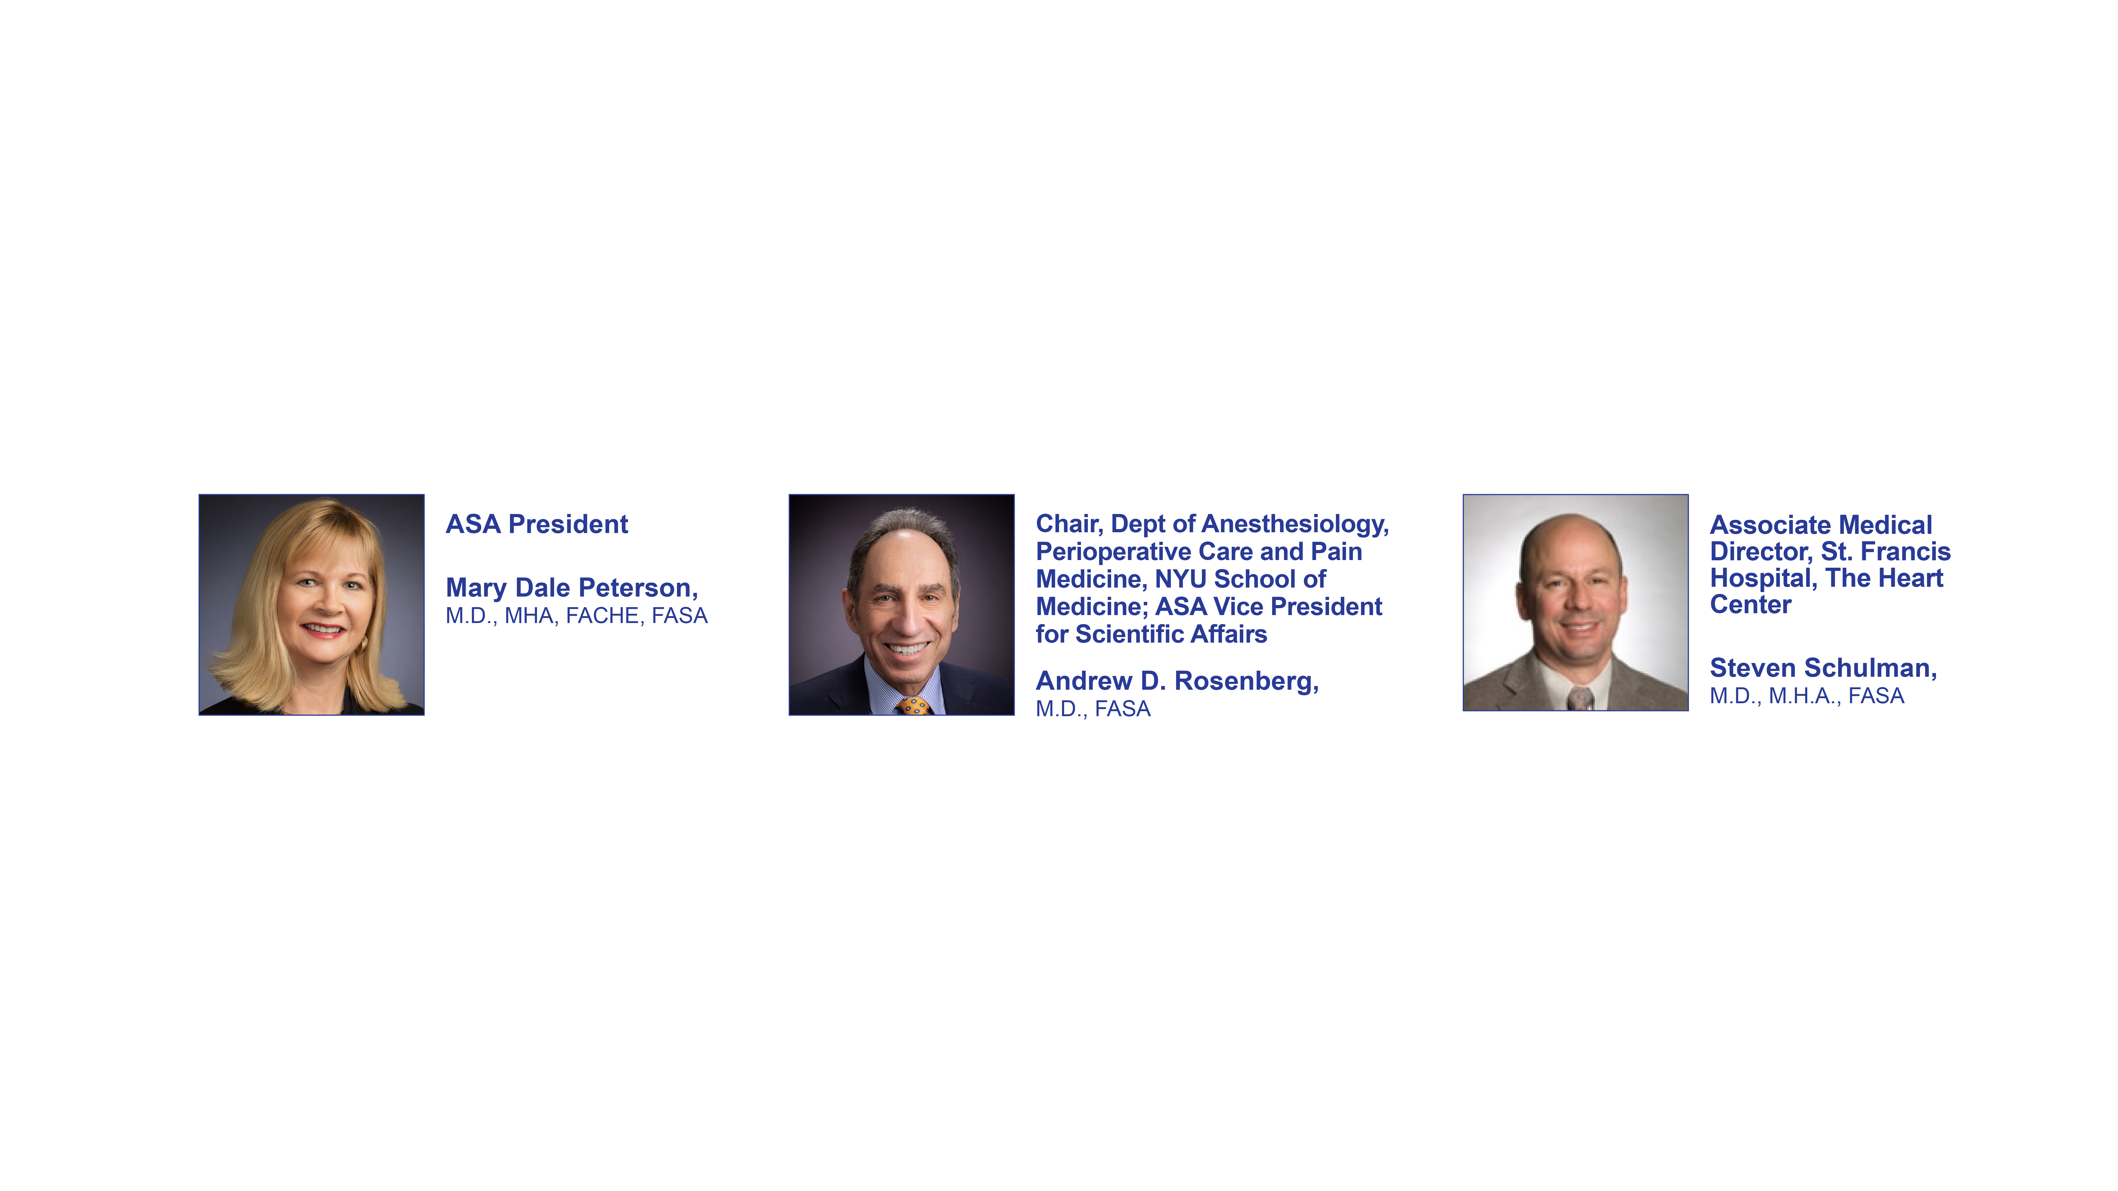
Panel Participants

Slide 9

Organizing an Academic Anesthesiology Department to Respond to the COVID Pandemic
April 2, 2020
Andrew D. Rosenberg, M.D. FASA
Professor and Dorothy Reaves Spatz M.D.
Chair, Department of Anesthesiology, Perioperative Care and Pain Medicine
NYU School of Medicine
ASA VP Scientific Affairs

Slide 10

Disclosures
None related to this topic.

Slide 11
Objectives
Outline organizational issues that need to be addressed when planning to respond to the COVID pandemic
Understand the vital value that our skill set provides as members of the anesthesia care team in helping to fight this pandemic
Discuss the care teams, equipment and supplies needed to help with the institutional response to the COVID pandemic

Slide 12
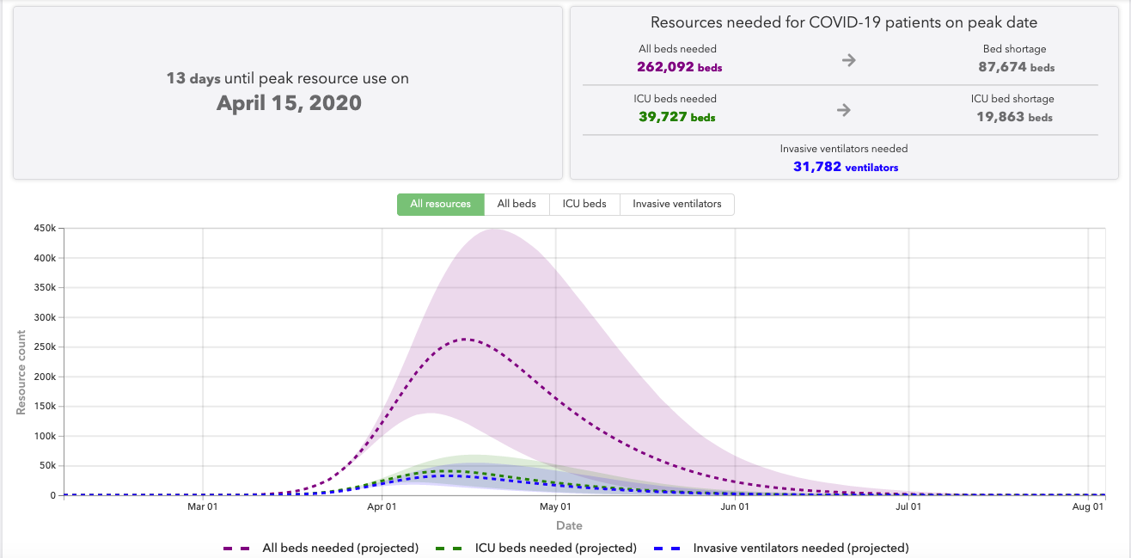
IHME Projections on Needs of ICU Beds & Vents
Notes:
Instittue of health metrics and evaluation

Slide 13
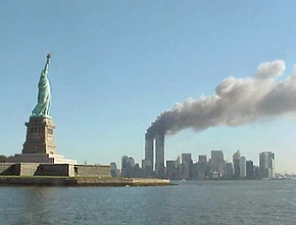

Organizational Issues
In NYC we experienced 9/11 and
Superstorm Sandy
While these were unprecedented,
we went right into a recovery phase
COVID pandemic is a different issue -
just presenting and will be here for a while
We gained department organization knowledge from those experiences
Need to be Organized and Nimble in Order to Address the Challenge!
Wikipedia. National Park Service
MTA Pic Entrance to Brooklyn Battery Tunnel

Slide 14
Our Role in an Academic Medical Center
We are on the front lines
This is what we are good at – caring for sick patients, intubations, ventilator management, ICU care, lines, prone positioning of patients
So makes sense to define our role instead of the institution telling us what we should be doing
Humbled at conviction, determination and dedication of our Physician anesthesiologists, CRNAs, residents & anesthesia tech staff
Collaborating well with others in our institution

Slide 15
Organizational Issues
Leadership
Disseminating information to entire Department
Workforce issues–scheduling and team approach
Equipment and supplies
  PPE
  Anesthesia Machines and supplies
  ORs

Slide 16
Organizational Issues
It is a marathon not a sprint but really seems to be a marathon being run at a sprint pace
Daily leadership conversations over video conferencing enables leadership to get input from multiple locations providing COVID care to determine needs, share experience, and determine next steps (1/2 hour to an hour and all get to weigh in)
Daily update disseminated to department members so people are kept knowledgeable and engaged
  Feedback has been very positive
  Address each location and note what is going on there and suggestions
  Also opportunity to express gratitude
Important to consider the emotional state of our personnel

Slide 17
Workforce Issues
Account for all staff
Organize staff and include down time at least early on as we are just in the beginning stages even here in NY which is getting hammered
Discuss issues such as schedule, vacation, call, overtime
We went to shifts - no longer weekdays vs weekends - no call
Collaborate with all locations to determine who is assigned to which location

Slide 18
Workforce Issues (continued)
Centralize overall schedule 1 leader- organizing 100s of people (critical resource)
Define Teams and Teams Leaders and let Team Leaders help make their schedule
Take into consideration that you will lose staff for various amounts of time as they become symptomatic and/or COVID +
Be flexible as staff needs increase for certain teams

Slide 19
Staff
Physician Anesthesiologists (OR and ICU)
CRNAs are a critical part of team
Residents are a critical part of the team
Play an important role so need to make sure they aren’t deployed elsewhere
Their schedules should be organized and fed into the Team schedules
Anesthesia Techs need to be available

Slide 20
Teams
OR teams - less need for this- really only emergencies (good on-site backup)
ICU attendings- Many major AMC have anesthesiology intensivists–we freed them from OR to focus 100% on ICU patients as COVID ICU floors open
A second pool of anesthesiologists was created that help with ICU management
Anesthesia care team members helping with vent management and other issues. Excellent collaboration among attendings, CRNAs, residents, anesthesia techs and the floor nurses so they understand how our anesthesia machines work- learning curve to this
AVPP team

Slide 21
AVPP Teams
Airways- Doing the intubations
Ventilation Management- Managing ventilator settings and supplies and equipment as necessary
Procedures- placing lines- A lines, central lines, IVs
Prone Positioning- Hope you saw the excellent presentation Dr. George Williams gave the other night describing benefits of prone positioning
We know the prone position, so can help with moving and proper positioning
Both Attendings and Residents are part of these teams AMC have this ability
These Teams are really appreciated by the clinicians and the hospital leadership!

Slide 22
Collaboration With Others is Key
We are Working in a Very Large Organization
Work with others in the institution
  Speak with leaders in C suite and inform them what is going on and your roles
  Participate in daily briefings – new floors opening and staffing models, vents etc
ID- Frequent conversations,
  Webinar to Department
  Constantly changing landscape for PPE and indications for use not only in perioperative area and COVID areas but maybe throughout the institution

Slide 23
Collaboration With Others is Key
We are Working in a Very Large Organization
ICU personnel and management - to define where best to deploy people
Emergency Management - to make sure you get needed PPE and supplies
Respiratory Therapy - know how many vents there are and work with them
Anesthesia Machines - know where you are going to deploy them and have an organized approach to manage and maintain vents and equipment for vents

Slide 24
Equipment
Account for all supplies and equipment
Centralize anesthesia machines from ambulatory and off-site locations
Keep daily tally of anesthesia machines and their locations (both those in use and spares)
Let those working overnight know location and latest counts in case of surge
If you think you might need something down the line- get it now or have a plan how you will be able to procure it as the need arises
Know where your equipment and supplies are being stored
Make sure you establish what ORs can be negative pressure and designate those now and maintain them as negative pressure

Slide 25
Use of Anesthesia Machines
Gain experience
Cohort your anesthesia machines
Think it best if you can have anesthesia machines and your anesthesia intensivists in same location
Experience helps you organize management issues- rounds, filters, water traps, CO₂ absorbers etc.
As things get worse, determine if you can to use all oxygen sources in the OR. Many ORs have oxygen and air sources in more than one location in OR

Slide 26
Summary
Developing an organized approach to this crisis is important
Each crisis is different but:
As anesthesiologists we are used to being flexible and need to use that ability to help the institution fight this issue
As anesthesiologists we have the clinical skill set to play an important role
Good leadership and organization sends a positive message so the staff knows things are under as much control as possible
Be safe!
Thank you

Slide 27
Lessons from the Front Line:
The Private Practice Perspective
Steven Schulman M.D., M.H.A., F.A.S.A.
Associate Medical Director
St. Francis Hospital, The Heart Center
Roslyn, NY
President
New York Cardiovascular Anesthesiologists, P.C.
Roslyn, NY

Slide 28
Agenda
St. Francis Hospital
Suburban, Community Hospital Response
Private Practice Concerns

Slide 29
Long Island Hospital Systems
Catholic Health System of Long Island
Northwell
NYU-Winthrop
Mt. Sinai-South Nassau
Stonybrook University Hospital
Nassau County Medical Center

Slide 30
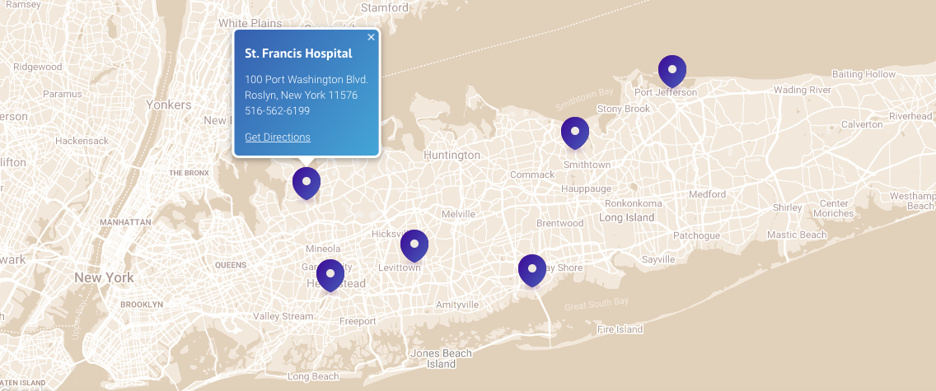
Catholic Health System of LI

Slide 31
St. Francis Hospital, The Heart Center
Med Surg Beds-224
ICU Beds-60
Operating Rooms-20
  Cardiac OR-6
  General OR-14
Total Ventilators Available-60
East Hills ASC-5

Slide 32
Suburban, Community Hospital Response
Timeline
Communication with Regional Anesthesia Groups
Internal Communication
Intubations
Critical Care
Surgical Case Review Committee

Slide 33
Timeline
March 1: 1st coronavirus patient identified in NY
March 6: 1st patient identified in Long Island
March 7: Governor Cuomo declares state of emergency
March 22: Governor Cuomo mandates cancellation of all elective surgery (effective March 25)
March 23: SFH cancels all elective procedures
March 23: Governor Cuomo mandates every NY hospital increase capacity 50%
March 30: Closure of all DeMatteis ORs (14), all emergent surgeries relocated to Heart Center ORs (6)

Slide 34
St. Francis Hospital, The Heart Center
Med Surg Beds-224 (increase to 336)
ICU Beds-60 (increase to 94)
Operating Rooms-20 6
  Cardiac OR-6
  General OR-14
Total Ventilators Available-60
East Hills ASC-5

Slide 35
St. Francis Hospital, The Heart Center
Med Surg Beds-224 (increase to 336)
  115+ pts, 73 PUI, 147+ pts, 66 PUI
ICU Beds-60 (increase to 94)
Operating Rooms-20 6
  Cardiac OR-6
  DeMatteis OR-14
Total Ventilators Available- 60 14 8 6
East Hills ASC-5 2

Slide 36
Communication with Regional Anesthesia Leadership
Anesthesia private practices traditionally exist in silos
Group texts, conference calls, video conference
Sharing
  Clinical experiences
  PPE availability
  Workforce allocations
  Reimbursement strategies

Slide 37
Internal Communication
ER, Critical Care, Respiratory Therapy
Group
Plan for Intubations
  Prior to crisis vs present
  Who? When? How?
Critical Care Coverage/Anesthesia Availability

Slide 38
Surgical Case Review Committee
Background
  Cuomo mandate to suspend elective surgery
Members
  Surgical chiefs, anesthesia, nursing, scheduling
Format
  Urgency
  Logistics (LOS, need for critical care)
Options (ASC)

Slide 39
Private Practice Concerns
New York Cardiovascular Anesthesiologists, PC (NYCA)
Key Support Systems
Communication
Financial Considerations
Lessons learned

Slide 40
NYCA, PC
Total Employees-50
  Shareholders-28
  Call Taking Physicians-31
  Non-Call Taking Physicians-4
  CRNAs
    FT-8
    Per-diem-8
  Office Staff-7

Slide 41
Key Support Systems
Legal
Accountant
Banker
Revenue Cycle Management

Slide 42
Communication
Frequent emails
Video conferencing
  CRNAs
  Shareholders

Slide 43
Financial Considerations
Shareholder Payroll
  Evaluate Accounts Receivable
  “Flatten the Curve”
Staffing
  Per-diem staff
  FT Employee CRNAs and physicians
CRNAs as ICU RNs
Transparency

Slide 44
Financial options to be considered
Critical care coverage
  CRNAs as ICU RNs
  Critical Care Anesthesiologists
  FFS vs hospital support
24/7 anesthesia/intubation/line coverage
  Hospital support
SBA loans/Medicare Advance/Line of credit

Slide 45
Lessons Learned
Legal advice
Responsibility as business owners
  “Share the pain”
Crowdsource ideas
Empathy
  “Lead with compassion”

Slide 46
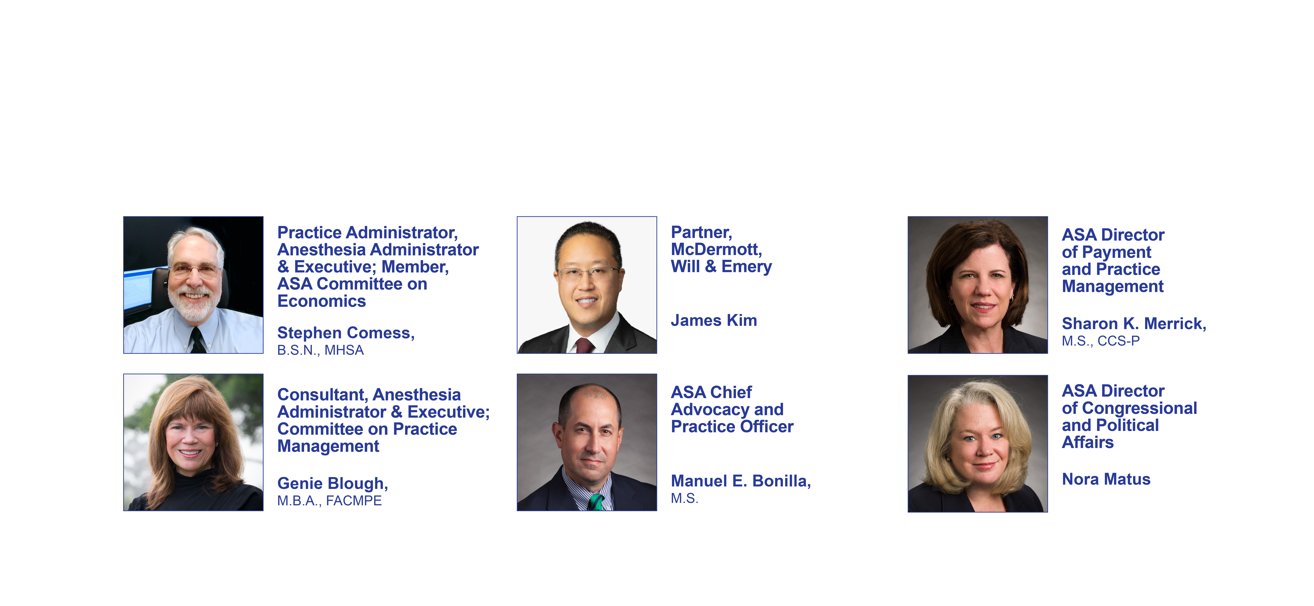
Panel Participants

Slide 47
On The Ground – Practice Issues
April 2, 2020
Stephen E. Comess
Executive Director,
United Anesthesia Services, P.C.

Slide 48
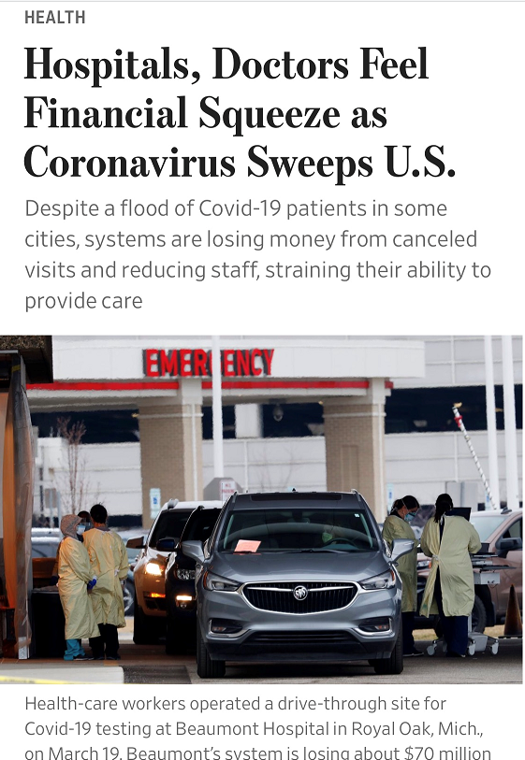
asahq.org | apsf.org
PAUL SANCYA/ASSOCIATED PRESS
Wall Street Journal, April 2, 2020

Slide 49
On The Ground – Practice Issues
Establish priorities –
  Safety of anesthesia personnel, service to patients and identifying resources available to assure ongoing operations not only during this event but what is needed
  to assure a viable organization or anesthesia department after this event is over.
Based on the priorities, establish a plan of action
  Resource Assessment - Personnel (full and part-time) Cashflow, A/R, stipends, collections.
  Identify current expenses
  Plan on expense reduction lasting for 4-6 months
  How will your plan fairly and sustainably be implemented:
    i.e. Shareholders / Partners shoulder the lion’s share of the burden
    Non-MD / CRNA impacts to share in the plan
    Benefits impact – essential versus non-essential – Health insurance versus CME, PTO, etc.
    Conveying that as operations return to normal, all staff will share in the benefits.

Slide 50
On The Ground – Practice Issues
Create expectations of modifications as demands change – your relationship with your facilities will be tested.
Explore all Federal, State and Local resources for support – prepare and submit applications and supporting documentation as soon as possible. Jump on it!
Explore and pursue support of staff safety – i.e. PPE supplies, aerosol boxes, etc. Anything that might factually help protect staff

Slide 51
On The Ground – Practice Issues
Communicate, communicate, communicate –
Make sure your department/leadership is putting out regular communications about clinical / safety policies, staffing, caseload, compensation, PTO, benefits, etc. Hold conference calls / GoToMeeting / Zoom sessions.

Slide 52
On The Ground – Practice Issues
We’re all in this together and it’s important that your staff know that leadership cares, is planning and executing strategies to support them and that we remain open to change as new issues / opportunities arise.

Slide 53
Immediate Options for Cash Flow
April 2, 2020
Sharon K. Merrick, M.S., CCS-P
ASA Director of Payment and Practice Management

Slide 54
Immediate Options for Cash Flow
Critical Care
Telehealth
CMS Accelerated/Advance Payment Program

Slide 55
Critical Care
CPT® Code | Descriptor | Medicare Allowed Amount (2020)
99291 | Critical care, evaluation and management of the critically ill or critically injured patient; first 30-74 minutes | $226.64
99292 | Critical care, evaluation and management of the critically ill or critically injured patient; each additional 30 minutes (List separately in addition to code for primary service) | $114.04
Criteria required to report is related to the illness/injury and the complexity of the care provided
Time based codes
Services bundled into critical care
  Vent management (CPT codes 94002, 94003, 94004)
More information: https://www.asahq.org/quality-and-practice-management/managing-your-practice/timely-topics-in-payment-and-practice-management/reporting-critical-care-services

Slide 56
Telehealth
Evaluation and Management (E/M) and certain other services generally provided in-person are performed with the patient and the health care professional in different locations through use of two-way, real-time interactive audio/video technology
Sweeping changes for duration of the Public Health Emergency (PHE)
  Available to any patient anywhere in the country
  Originating site may be patient’s home and distant site may be the provider’s home
  CMS list of services that may be provided via telehealth expanded
More information: https://www.asahq.org/quality-and-practice-management/managing-your-practice/timely-topics-in-payment-and-practice-management/telehealth-background-and-flexibilities-extended-during-the-public-health-emergency

Slide 57
CMS Accelerated/Advance Payment Program
Existing program to provide funds when claims submission and/or processing systems are disrupted; expanded for the duration of the PHE
Key Points:
  May request up to 100% of your Medicare payment amounts for a three-month period
  Medicare Administrative Contractors (MACs) receive/ review requests with goal to issue funds within seven (7) days of the request
  Repayment is by recoupment
    To start 120 days after payment issued and full repayment by 210 days from issue
More information: https://www.cms.gov/files/document/Accelerated-and-Advanced-Payments-Fact-Sheet.pdf

Slide 58
The CARES Act
April 2, 2020
Nora Matus
ASA Director of Congressional and Political Affairs

Slide 59
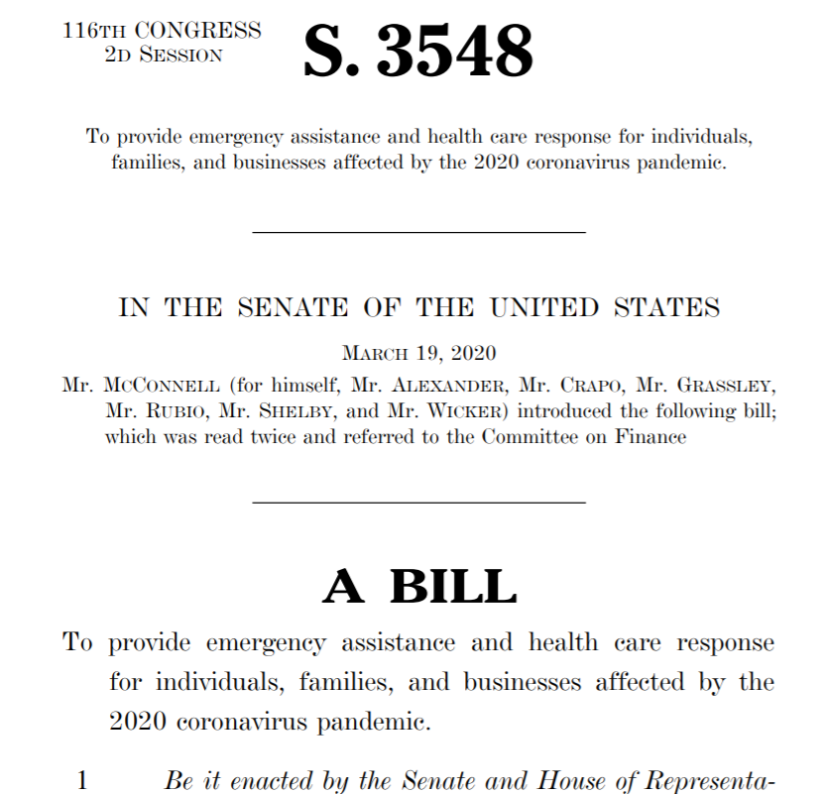
The CARES Act: Recent Federal Legislation to Support Physician Practices
$2 Trillion in federal assistance to families and businesses
$100 Billion in grants for health care providers
$349 Billion in SBA Paycheck Provider Program loans
Economic Injury Disaster Loans (EIDL)
Tax provisions
Student loan payment deferment and interest waiver
More information: www.asahq.org/economicimpact

Slide 60
CARES Act:
U.S. Department of Health & Human Services (HHS)
Public Health and Social Services Emergency Fund
$100B grant program for eligible healthcare providers for healthcare-related expenses or lost revenues associated with COVID-19.
Non-reimbursable expenses attributable to COVID-19 qualify for funding. Examples include building or retrofitting new ICUs, increased staffing or training, personal protective equipment, the building of temporary structures and more. Forgone revenue from cancelled procedures, which has put significant strain on the health care system, is also a qualified expense.
This fund can only be used for non-reimbursable expenses.
STATUS: Health and Human Services (HHS) is in the process setting criteria for the application process.

Slide 61
CARES Act:
Small Business Administration (SBA)
Paycheck Protection Program
  $349 Billion to incentivize job retention
Eligible recipients may qualify for a loan up to $10 million determined by 8 weeks of prior average payroll plus an additional 25% of that amount.
Loan payments will be deferred for six months.
If you maintain your workforce, SBA will forgive the portion of the loan proceeds that are used to cover the first 8 weeks of payroll and certain other expenses following loan origination.
Status: Active Friday, April 3

Slide 62
CARES Act:
Small Business Administration (SBA)
7 A Loan Guarantee Program
  Maximum 7(a) loan amount increased from $5 million to $10 million.
  Expands eligible uses of 7(a) loans to include payroll support, employee salaries, mortgage payments, insurance premiums and other debt obligations.
  The SBA will also pay the principal and interest of new 7(a) loans issued prior to September 27, 2020.
  The SBA will pay the principal and interest of current 7(a) loans for a period of six months.
Economic Injury Disaster Loan
  $10 Billion program provides small businesses with working capital loans of up to $2 million that can provide vital economic support to small businesses to help overcome the temporary loss of revenue they are experiencing.
  $10,000 loan advance will provide economic relief to businesses that are currently experiencing a temporary loss of revenue. Funds will be made available within three days of a successful application, and this loan advance will not have to be repaid.
  Status: Active

Slide 63
CARES Act: Internal Revenue Service (IRS)
Employee Retention Credit
  Refundable tax credit is 50% of up to $10,000 in wages paid by an eligible employer whose business has been financially impacted by COVID-19.
Qualifying employers must fall into one of two categories:
  The employer’s business is fully or partially suspended by government order due to COVID-19 during the calendar quarter.
  The employer’s gross receipts are below 50% of the comparable quarter in 2019. Once the employer’s gross receipts go above 80% of a comparable quarter in 2019, they no longer qualify after the end of that quarter.
Status: Active

Slide 64
CARES Act: Internal Revenue Service (IRS)
Deferred Social Security tax
  Employers and self-employed individuals allowed to defer payment of their employer share of the Social Security tax until Dec. 31. The deferred amounts would be paid over the following two years, with half of the amount required to be paid by Dec. 31, 2021, and the other half by Dec. 31, 2022.
  Status: Active
Federal tax rebates
  One-time federal income tax rebate for eligible physicians and their employees in 2020.
  $1,200 for individuals
  $2,400 for joint filers
  $500 for each child.
  Status: 3 Weeks
Retirement account withdrawals
  Allows for withdrawal of up to $100,000 from retirement funds (i.e., 401K, etc.) in 2020 without penalty

Slide 65
CARES Act: Department of Education
Interest on student loans held by the U.S. Department of Education has been waived for at least sixty days beginning March 13, 2020.
Includes Direct Loans, as well as Federal Perkins Loans and Federal Family Education Loan (FFEL) Program loans held by the Department.
Administrative forbearance on loan payments effective March 13, 2020 for at least sixty days.
To request administrative forbearance, StudentAid.gov/login
or 1-800-4-FED-AID (1-800-433-3243)
  STATUS: Active

Slide 66

SBA Assistance During the COVID-19 Crisis:
What’s Available?
April 2, 2020
James Kim, McDermott Will & Emery

Slide 67
What is the "CARES Act?"
The Coronavirus Aid, Relief, and Economic Security (CARES) Act was adopted by Congress and signed into law by President Trump on Friday, March 27.
The 880-page bill is intended to help small and large businesses, individuals, and the health care sector weather the economic storm caused by the unprecedented COVID-19 pandemic.
Title I of the CARES Act—titled “Keeping American Workers Paid and Employed”—is specifically focused on helping small businesses survive this economic crisis through the establishment of the Paycheck Protection Program (PPP) and bridge loans under the PPP administered through the Small Business Administration (SBA).

Slide 68
The Paycheck Protection Program
The 7(a) loan program is the SBA’s primary program for providing financial assistance to small businesses. The CARES Act would increase the maximum 7(a) loan amount to $10 million, expand allowable uses of 7(a) loans as described below and, permit forgiveness of a portion of the loan based on certain requirements.
Under the CARES Act, the covered loan period for this program would begin on February 15, 2020, and end on June 30, 2020.

Slide 69
Who Is An Eligible Recipient for a
Covered Loan?
The legislation increases eligibility for certain small businesses and organizations.
Small businesses, 501(c)(3) nonprofit organizations, 501(c)(19) veterans organizations and tribal businesses.
  Fewer than 500 employees (unless the covered industry’s SBA size standard allows more than 500 employees).
Businesses in the hospitality and restaurant industries with one or more physical location/store and with no more than 500 employees per physical location.
Franchises that are approved on the SBA’s Franchise Directory.
Small businesses that receive financing through the Small Business Investment Company (SBIC) program.

Slide 70
Application Period
Starting April 3, 2020, small businesses and sole proprietorships can apply for and receive loans to cover their payroll and other certain expenses through existing SBA lenders.
Starting April 10, 2020, independent contractors and self-employed individuals can apply for and receive loans to cover their payroll and other certain expenses through existing SBA lenders.
Apply through an existing SBA lender or through any federally insured depository institution, federally insured credit union, and Farm Credit System institution that is participating.
Visit www.sba.gov for a list of SBA lenders.
Applications and documentation must be submitted by June 30, 2020.

Slide 71
Eligibility Criteria – Easing and Expediting the Process
The legislation gives approved SBA lenders the delegated authority to make and approve loans.
In evaluating a borrower’s eligibility, an SBA lender must consider: whether a business was operational on February 15, 2020 and had employees for whom it paid salaries and payroll taxes.
The eligibility criteria for an SBA loan are eased under the PPP, and the process for applying is made easier.

Slide 72
Who is an "Employee" for Purposes of the PPP
For purposes of calculating how many employees a business concern has under the PPP, an employee is defined as those who are employed on a full-time, part-time or “other basis.”
The law provides for waiver of the affiliation rules for “any business concern operating as a franchise that is assigned a franchise identifier code by the Administration.”

Slide 73
Borrower’s Good Faith Certification
An eligible recipient (borrower) must make a good-faith certification that:
(1) the uncertainty of current economic conditions make the loan request necessary to support ongoing operations and that they will use funds to retain workers and maintain payroll and other debt obligations, and
(2) a borrower does not have an application pending for a loan for the same purpose and duplicative of amounts applied for or received under a covered loan, nor has it received such a loan between February 15, 2020 and December 31, 2020.

Slide 74
How is the Covered Loan Amount Determined?
The loan amount of a covered loan will be the average monthly payroll for the past year multiplied by 2.5, or $10 million, whichever is less.
Loan amounts for seasonal or new businesses (which cannot demonstrate average monthly payrolls for the previous 12-month period) are calculated using a modified formula.
Also, under the law, payroll costs do not include “the compensation of an individual employee in excess of an annual salary of $100,000, as prorated for the covered period.”
The legislation also excludes the compensation of an employee whose principal place of residence is outside the United States.

Slide 75
Calculation the Loan Amount – an example
Expense 12-Month Avg.
Payroll $23,145
250% of Monthly Avg. $57,862
“Payroll costs” are a defined term in the law, and include payments of compensation for salary, wage or commission; cash tip or equivalent; payments for vacation, parental, family, medical or sick leave; payments required for group health benefits, including insurance premiums; and payment of state and local tax assessed on compensation of employees.

Slide 76
What Expenses Can I Pay For With a Covered Loan?
Eligible expenses include the following:
Payroll costs
Costs related to group health care benefits during the periods of paid sick, medical or family leave, and insurance premiums
Employee salaries
Mortgage interest costs
Rent
Payment of utility bills
Interest on other debt obligations

Slide 77
Other Critical Provisions About Covered Loans Under the PPP
0.5% fixed interest rate, and two years to repay outstanding balance.
Both borrower and lender fees for 7(a) loans are be waived.
The SBA “credit elsewhere” test, personal guarantee and collateral requirements are waived during the covered period.
Lenders are required to provide complete deferment of 7(a) loan payments for not less than 6 months and not more than 1 year, including payment of principal, interest, and fees. SBA is required to disseminate guidance on the deferment process within 30 days.
Existing loans made under the SBA’s Disaster Loan Program between January 31, 2020, and the date on which covered loans are made available, may be refinanced as part of a covered 7(a) loan.

Slide 78
Loan Forgiveness
The PPP provides a process by which borrowers would be eligible for loan forgiveness based on --
The amount spent by the borrower during an eight-week period after the origination date of the loan on the following items:
  Payroll costs
  Interest payment on any mortgage incurred prior to February 15, 2020
  Payment of rent on any lease in force prior to February 15, 2020
  Payment on any utility for which service began before February 15, 2020.
Note: This does not tie exactly to permitted uses of funds.

Slide 79
Loan Forgiveness (Continued)
The amount forgiven is reduced in proportion to any reduction in employees retained compared to the prior year; and to the reduction in payroll beyond 25% of their prior year compensation.
Employers will not be penalized for reductions in number of employees or employee pay if they rehire workers or restore pay that was reduced prior to June 30, 2020.
Note that additional documentation must be provided as part of the loan forgiveness process, including payroll tax filings, and records related to mortgage, rent and utility payments.

Slide 80
Permitted Uses and Loan Forgiveness
Permitted Uses Loan Forgiveness
Payroll Yes.
Mortgage interest Yes, if mortgage incurred prior to 2/15/20.
Rent Yes, if lease in force prior to 2/15/20.
Utilities Yes, if service began prior to 2/15/20.
Interest on prior debt No.
Limited to 8 weeks after origination date.

Slide 81
SBA Express Bridge Loans
The SBA’s Express Bridge Loan (EBL) program allows SBA Express lenders to provide expedited financing to small businesses located in declared disaster areas.
  Express Bridge loans are intended to be interim loans. Businesses use these funds for disaster-related purposes while they apply for and await long-term financing.
Max loan is $25,000, for small businesses only (no waivers).
  Important for the smallest businesses who need funds urgently.
See updated SBA EBL program guide for more information.

Slide 82
SBA Express Bridge Loans (Continued)
Effective March 25, 2020, SBA expanded program eligibility to include small businesses nationwide that are adversely affected under the COVID-19 Emergency Declaration issued by President Trump on March 13.
  Because the declaration covers all states, territories, and D.C., eligible small businesses under the EBL program include small businesses located in any state, territory and D.C. that have been adversely impacted by COVID-19.
In the same notice, SBA extended the term of the EBL program through March 13, 2021.
  EBL loans can usually only be made up to six months after the date of an applicable disaster declaration, but for COVID-19, EBL loans can be approved through March 13, 2021.

Slide 83
Economic Injury Disaster Loans (EIDL)
The first COVID-19 relief bill contained a provision enabling the SBA to make an estimated $7 billion in low-cost loans to affected small businesses in the form of EIDLs.
  EIDLs are available after a governor makes a disaster declaration pursuant to the Stafford Act and the President subsequently approves the declaration.
Once a state disaster declaration is approved, EIDLs offer up to $2 million in assistance per small business.
  The loans can be used to pay fixed debts, payroll, accounts payable and other bills that can’t be paid due to the disaster.
  The interest rate is 3.75% for businesses without credit available elsewhere (those with credit available elsewhere are not eligible) and 2.75% for nonprofits.
  SBA offers loans with long-term repayments, up to a maximum of 30 years.
  Borrowers cannot use EIDLs and PPP loans for the same purposes.

Slide 84
EIDLS (Continued)
The CARES Act contained a provision to allow entities that have applied for EIDL loans due to COVID-19 can receive an advance on that loan of no more than $10,000, which the SBA must distribute within three days.
  Applicants are not be required to repay advances, even in instances where the EIDL loan is subsequently denied
Advance can be used for paid sick leave, payroll, rent and mortgage payments, meeting increased costs to obtain materials unavailable from the applicant’s original source due to interrupted supply chains, and repaying obligations that cannot be met due to revenue losses.
Small businesses can visit the SBA’s website for more information on EIDLs.

Slide 85
Ability to Defer Payroll Taxes
Section 2302 of the CARES Act grants significant latitude to delay paying payroll taxes (6.2% for Social Security).
Employers may defer payments of those payroll taxes for 2020 over the following two years, with half of the amount required to be paid by December 31, 2021 and the other half by December 31, 2022.
IMPORTANT NOTE: businesses that receive loan forgiveness under CARES (available under Sections 1106 or 1109) will be ineligible for these deferred tax payments.
  So, one must weigh loan forgiveness against possible deferred tax payments.

Slide 86
Employee Retention Credit
Section 2301 of the CARES Act offers an “employee retention” tax credit: a 50% tax credit for wages paid [A] in a calendar quarter where revenues are less than 50% of the prior calendar year quarter, or [B] in a calendar quarter where the business has been fully or partially suspended due to government orders limiting commerce, travel, or group meetings
These credits apply to wages paid after March 12.

Slide 87
Employee Retention Credit (Continued)
These credits turn on the number of employees. For employers of 100 or more employees, the tax credit applies in either qualifying period but only to wages paid “for which the qualifying employee is not providing services” due to those circumstances. For employers of less than 100, however, the tax credit applies even when the employees are working.
For determining which entities should be aggregated for counting employer size for this purpose, “[a]l persons treated as a single employer under…the Internal Revenue Code of 1986…shall be treated as one employer for purposes of this section.”

Slide 88
Expansion of Unemployment Insurance Benefits
The CARES Act also expands unemployment insurance benefits:
Unemployment benefits will be available for those unemployed as a result of COVID-19 between January 27, 2020 and December 31, 2020.
There will be an extra $600 per week in benefits through July 31, 2020.
There will be funding to eliminate the traditional waiting period.
13 extra weeks of benefits will be added on to the existing number of weeks of benefits.

Slide 89
Key Takeaways
The SBA process to receive a loan through the PPP under the CARES Act has been greatly streamlined, an expected turnaround time to receive funds is a matter of days, prepare your application immediately.
You will need to process the application through a bank that supports SBA loans.
Loan amount is 2.5 times average monthly payroll, which includes associated state taxes and health benefits, average loan will be in the range of $40-$45k, will vary by volume
Eligibility is based on less than 500 employees per physical location.

Slide 90
Key Takeaways (Continued)
Borrowers are eligible for loan forgiveness equal to the expense incurred for the eight-week period after the origination date of the loan, based on payroll, mortgage interest, rent, and utilities
Employers will not be penalized (reduced loan forgiveness) for reductions in number of employees or employee pay if they rehire workers or restore any pay that was reduced prior to June 30, 2020
Loan amounts not forgiven have a fixed 0.5% interest rate over 2 years.
For more information, visit: https://www.sba.gov/funding-programs/loans/paycheck-protection-program-ppp

Slide 91
Thank you!
Questions?

Slide 92
COVID-19 Town Hall Webinar
April 2, 2020
Manuel Bonilla
ASA Chief Advocacy and Practice Officer

Slide 93
Next Steps
CARES Act Implementation
“Phase 4” Legislation (April 20?)
  Additional Funding for Physician Practices (+ up $100B grant)
  Small Business Administration
  Liability Relief
  Other
HHS/CMS
  Enhance Existing Medicare Payments
  New Payment Models

Slide 94
Share Your Stories
How has COVID-19 changed your daily life and practice?
What poignant or uplifting patient care situations have you experienced?
Please share! Email pr@asahq.org

Slide 95
Thank You and Be Well
Your participation in this webinar enables you to claim CME credits at www.asahq.org/covid19cme0402
Replay will also available at www.asahq.org/townhalls within 24 hours. Please share with your colleagues who weren't able to participate tonight.
Additional and ongoing COVID-19 resources at www.asahq.org/covid19info
asahq.org | apsf.org
Notes:
DR. PETERSON CLOSING REMARKS
CME is available
Replay will be available within 48 hours
We are truly all in this together...
Thank you so much for the work you are doing...

