Slide 1
COVID-19 Town Hall Webinar
March 26, 2020

Slide 2
Housekeeping
For this broadcast, your camera and microphone have been disabled. We encourage you to interact with other participants in the Chat, located at the bottom of the broadcast window.
Submit questions to the panel using the Q&A box at the bottom of the broadcast window, not through the Chat.
If you have technical issues, please close your browser and restart the webinar – or perhaps move closer to your router.
We are recording this broadcast today and will be adding the full video to the ASA website to view on demand or share with your colleagues within the next 24-48 hours.
asahq.org | apsf.org

Slide 3
Disclaimer
As a reminder, the items we discuss today are provided for informational purposes only and do not constitute medical or legal advice. As always, you should consult with your own medical and legal counsel.

Slide 4
Learning Objectives
At the end of this course, learners will be able to:
Identify the use of N95 masks and prioritizing the protection of the workforce
Define the process of repurposing anesthesia gas machines to ventilators
Discuss considerations for converting ORs to ICUs, in collaboration with critical care teams
Review important and practical information to help take care of COVID-19 patients

Slide 5
Welcome, Anesthesia Community
Anesthesia Care Team: Anesthesiologists, Anesthesiology Assistants, Nurse Anesthetists, Anesthesia Techs, Anesthesia Administrators and Executives
American Society of Anesthesiologists
Anesthesia Patient Safety Foundation
Society of Critical Care Anesthesiologists
Society of Critical Care Medicine
Hospital and health system leaders

Slide 6
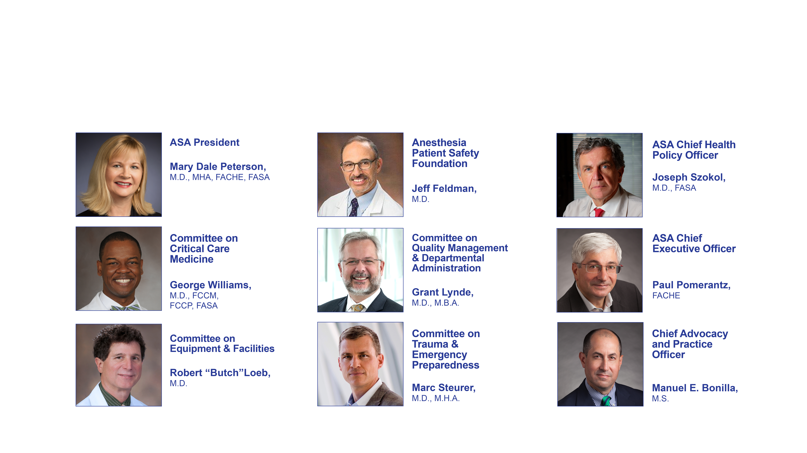
Panel Participants

Slide 7
Anesthesia Machines as ICU Ventilators
Jeffrey Feldman, MD | Chair, APSF Committee on Technology
Robert “Butch” Loeb, MD | Chair, ASA Committee on Equipment and Facilities
March 26, 2020

Slide 8
Why is this Important?
Patients are expected to die from respiratory failure due to an insufficient supply of ICU ventilators
Anesthesia machines are available and have ventilators capable of treating respiratory failure
Anesthesia professionals can put these machines into service and insure safe and effective function
NO PATIENT SHOULD DIE FROM RESPIRATORY FAILURE IF THERE IS AN ANESTHESIA MACHINE AVAILABLE THAT COULD SAVE THEM

Slide 9

Facilitating Factors
Cancelled elective procedures – available machines, disposables and personnel
FDA approved “off-label” use of anesthesia machines as ventilators
(https://www.fda.gov/medical-devices/letters-health-care-providers/ventilator-supply-mitigation-strategies-letter-health-care-providers)
Manufacturers (GE, Draeger, Mindray, Maquet) issued specific guidance on the off-label use of their devices
APSF/ASA Guidance: www.asahq.org/ventilators
  Purposing Anesthesia Machines as ICU Ventilators
  Quick Reference: “Setup and Monitoring Instructions –
  Anesthesia Machine as an ICU Ventilator”

Slide 10
Barriers
Getting the machines to the patients or the patients to the machines
  Surgicenters, NORA and other off-site locations
  Alarms and controls are not networked
Ensuring access to adequate disposables – CO₂ absorbents
Protecting machines from contamination
https://www.apsf.org/faq-on-anesthesia-machine-use-protection-and-decontamination-during-the-covid-19-pandemic/
Patient monitoring and documentation
Knowledge about how to effectively use the devices that you have
  Most are very capable ventilators but there are differences – Modes, Specs
Comfort with long term management of respiratory failure patients

Slide 11
Recommendations
Anesthesia professional immediately available 24x7 to manage/monitor the anesthesia ventilator and assist with respiratory care
Inhaled anesthetics NOT used and vaporizers disabled
Read the Guidance from APSF/ASA: www.asahq.org/ventilators
  Links to Manufacturers guidance and resources including technical support lines
Download the Quick Reference Guide and modify as needed for your local situation
Prepare in advance!
  Where are the machines? Where will you use them? How will you staff this? …

Slide 12
Key Considerations
Obstruction by the scavenging system
Don’t deliver anesthetics
Inspired O2 may be lower than set O2
Long-term use issues
  Providing humidification
  Managing condensed water accumulation
  Conserving compressed oxygen
  Changing filters / filter obstruction
  Performing periodic self tests
Start with pre-use self test with accurate compliance compensation
Obtain baseline flow and pressure tracings, and flow-volume loops
Have manual resuscitator available

Slide 13
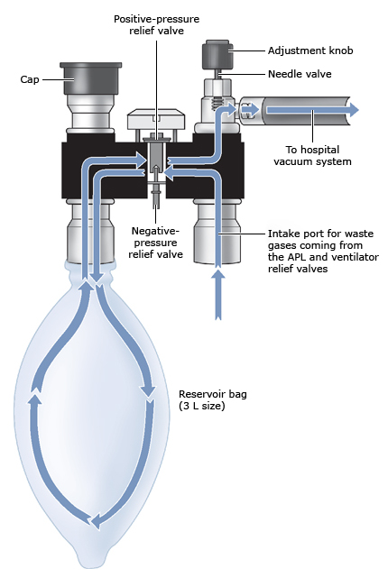
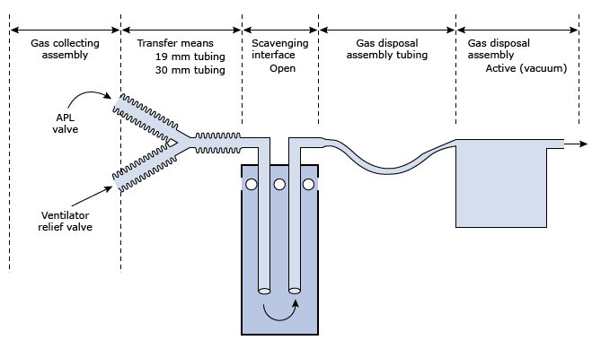
Scavenging System
Not required unless using inhaled anesthetics
Connection may not be compatible with wall suction outlet

Slide 14
Humidification
Need for humidification
  Mucus plugging
  Respiratory endothelial effects
Problems with humidification
  Condensation within tubing
  Hidden condensation (e.g., within absorbent canister or ventilator piston)
  Condensation effects on sensors
  Condensation effects on valves
  Condensation effects on absorbent
  Potential for electrical failure of components
Recommendations
  Discourage active humidification
  Encourage HMEF at airway
  Encourage increasing FGF if condensation becomes a problem
  Monitor spirometry for: HMEF obstruction, condensed water, leak around ETT

Slide 15
Oxygen Consumption
ICU ventilators consume oxygen at ~ MV * FiO2
Bellows anesthesia machines consume ~ FGF * FiO2 plus MV * 100%
  Replumbing to use compressed air as drive gas takes <1h by trained technician
  Bellows anesthesia machines air as drive gas consume FGF * FiO2
Piston or turbine anesthesia machines consume FGF * FiO2

Slide 16
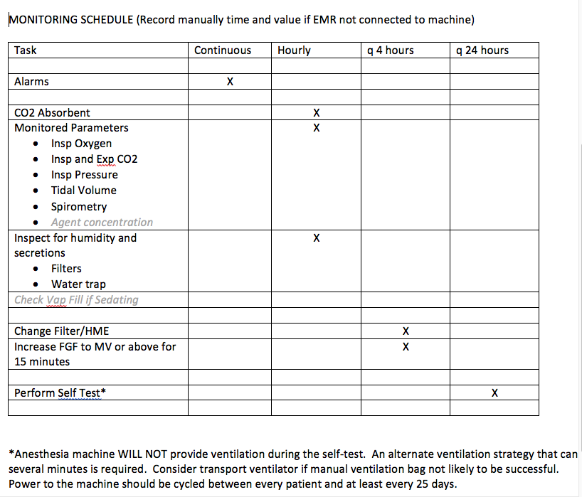
Maintenance Monitoring
Machines not intended to be used for multiple hours to days
Monitoring schedule to ensure continued proper function
Recommended tasks and intervals
A word about the Self Test

Slide 17
COVID-19 Critical Care Medicine Review
George Williams, MD, FASA, FCCM, FCCP
Chair, ASA Committee on Critical Care Medicine
March 26, 2020

Slide 18
Disclosures
None

Slide 19
Disaster Care
Be flexible
The ICU is a team sport
Appreciate everyone’s limits…and expertise
Overcommunication is best…

Slide 20
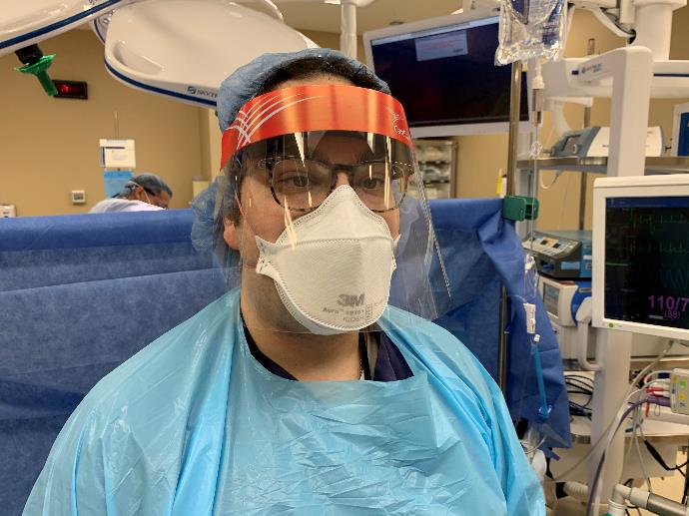
PPE/Exposure
Memorization is not the answer
Mobilize layout/leverage technology
Minimize bronchoscopy
“DON’T BECOME A VICTIM”

Slide 21
Pathophysiology
Transmission
Spike protein
ACE2 Receptor
High relative receptor affinity
  Alveolar pneumocytes
  Stratified epithelial cells
  Absorptive enterocytes
Rothan HA, Byrareddy SN. The epidemiology and pathogenesis of coronavirus disease (COVID-19) outbreak. J Autoimmun. 2020 Feb 26:102433.

Slide 22
https://sccm.org/Blog/March-2020/United-States-Resource-Availability-for-COVID-19

Slide 23
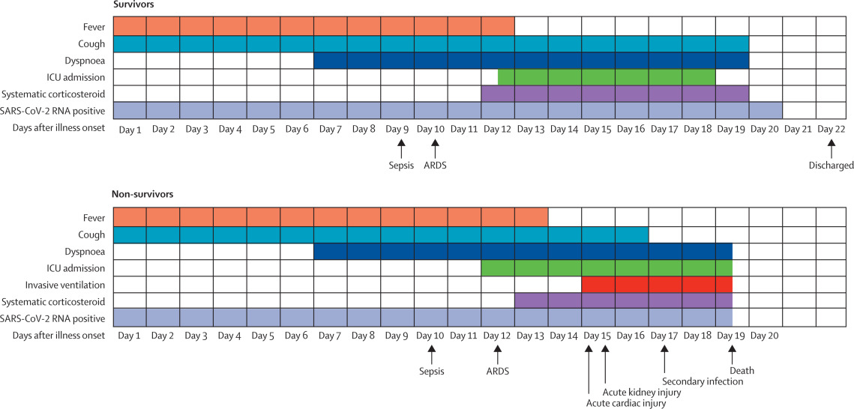
Clinical Course (Wuhan | Italy)
Zhou F, Yu T, Du R et al. Clinical course and risk factors for mortality of adult inpatients with COVID-19 in Wuhan, China: a retrospective cohort study. Lancet. 2020 Mar 11. pii: S0140-6736(20)30566-3.
Pulmonary Embolism
Pulmonary Hemorrhage

Slide 24
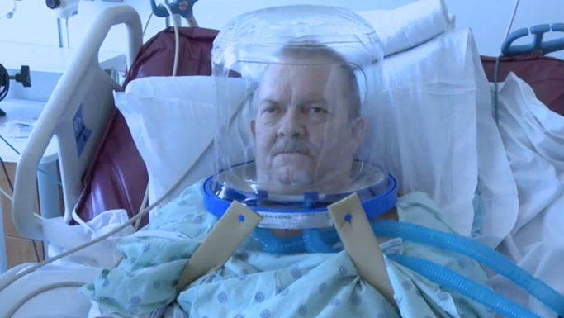
Non-Invasive Ventilation
High Flow Nasal Cannula
CPAP/BiPAP
Face Tents
©2016 www.uchicagomedicine.org/

Slide 25
Plateau Pressure
Peak Inspiratory Pressure
PEEP
“Breath Hold”/Inspiratory Pause if available

Slide 26
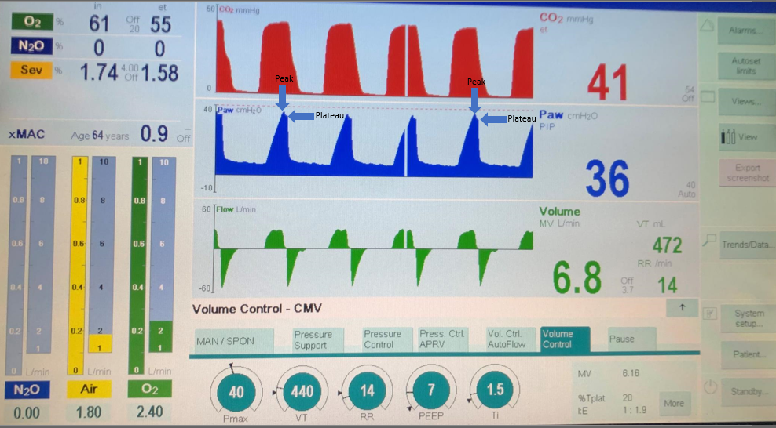

Slide 27
Peak Inspiratory Pressure
Peak Inspiratory Pressure
Plateau Pressure
Plateau Pressure
Poor compliance
PEEP
High airway resistance

Slide 28
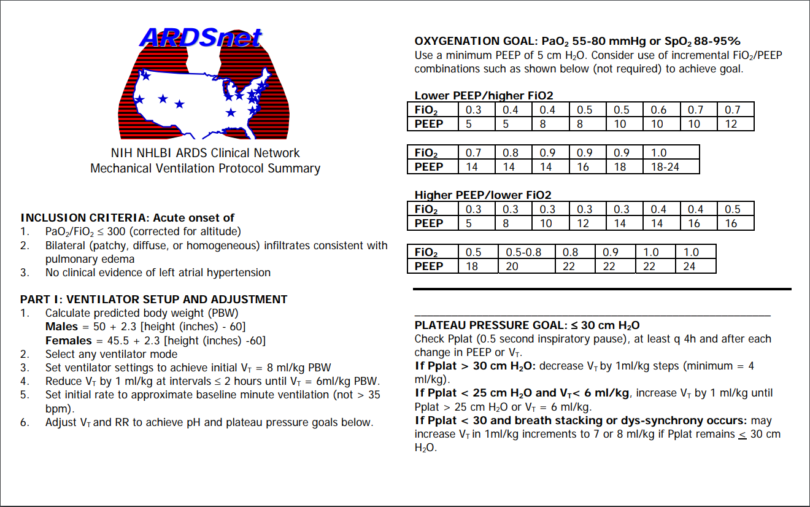
Ideal Body Weight (males)= Height in cm – 100
Ideal Body Weight (female)= Height in cm – 100
Height in cm: 177cm → 77kg Ideal Body Weight
*Measure your results*

Slide 29
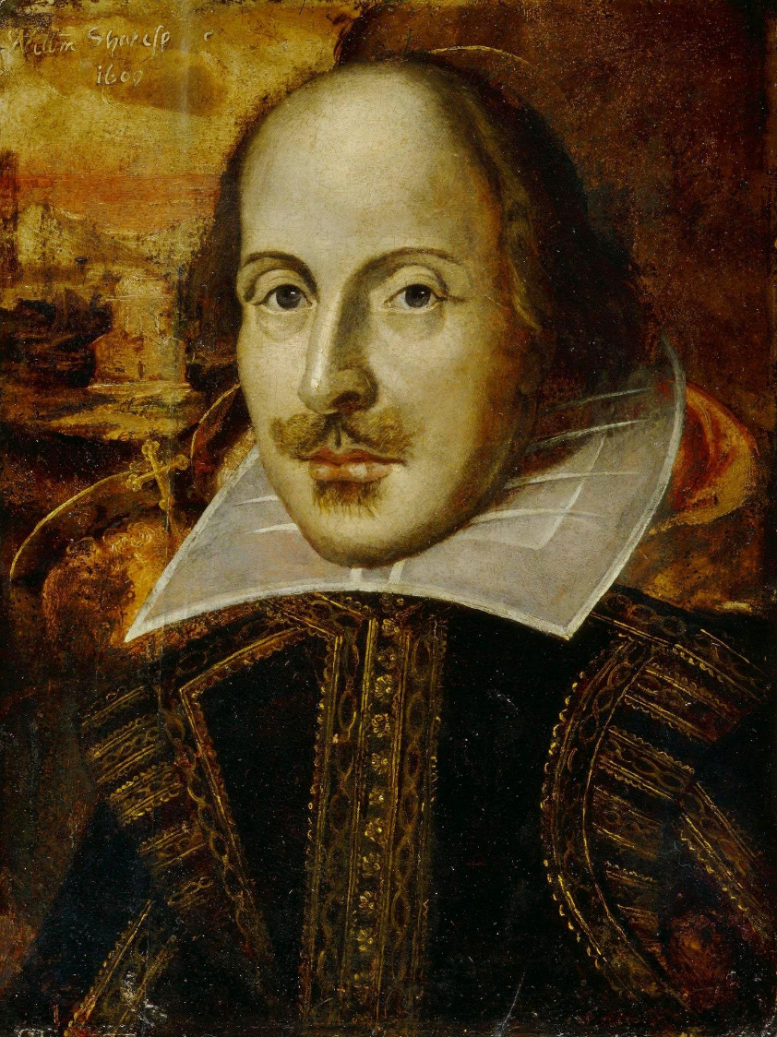
TUBE or
not
TUBE…
That is the question

Slide 30
Hypoxia Therapies
Worsening
Always ↓ ventilator induced lung injury (VILI)
PEEP
Recruitment maneuvers
Prone (deep sedation) +/- NMB
Nitric oxide??
ECMO (V-V or V-A)

Slide 31

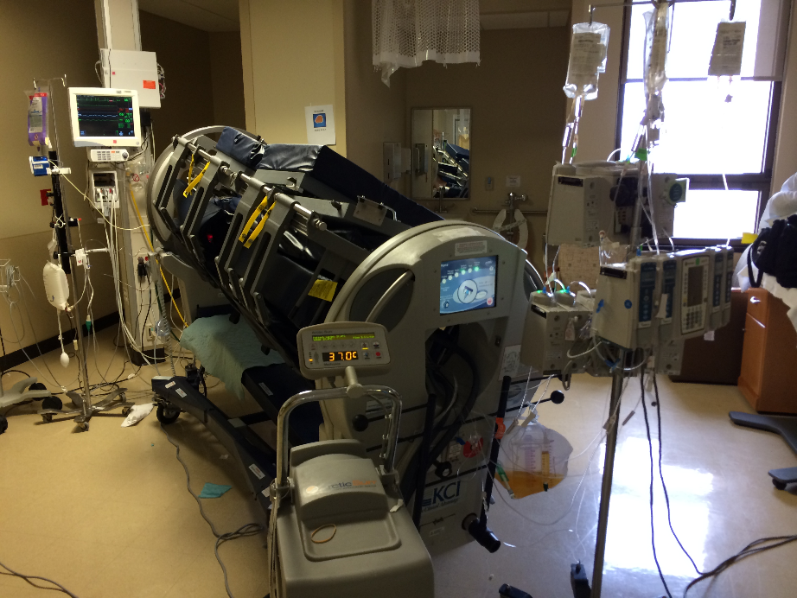
Prone position
Indications
-↓ mortality (33% → 16%)
Logistics
Risks

Slide 32
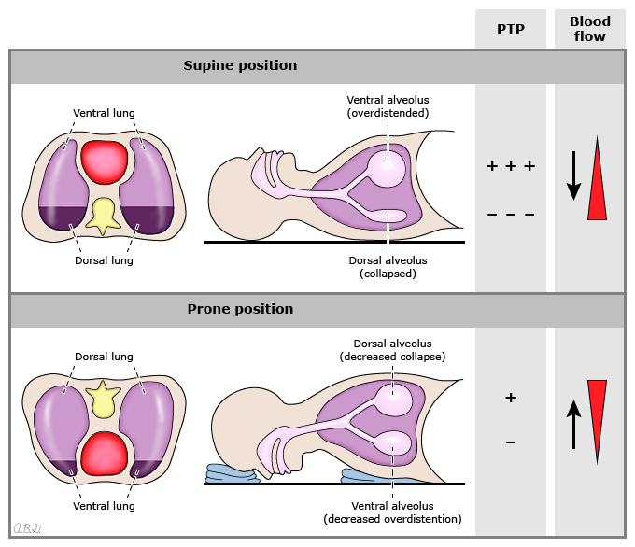
Transpulmonary Pressure: PTP
©UpToDate

Slide 33
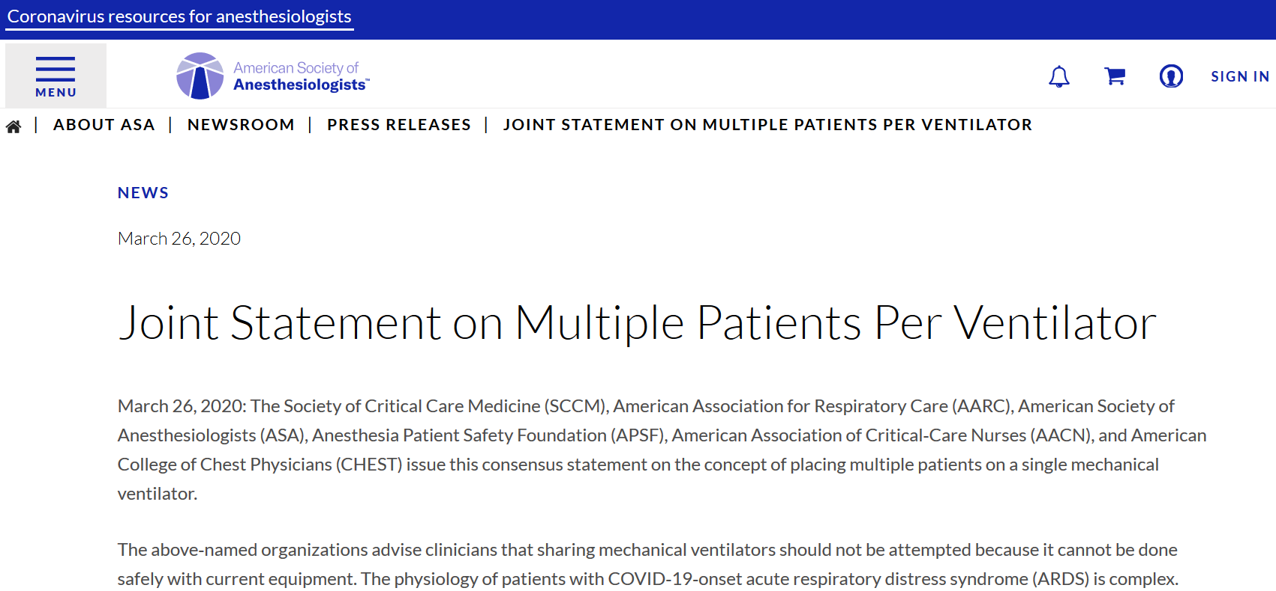
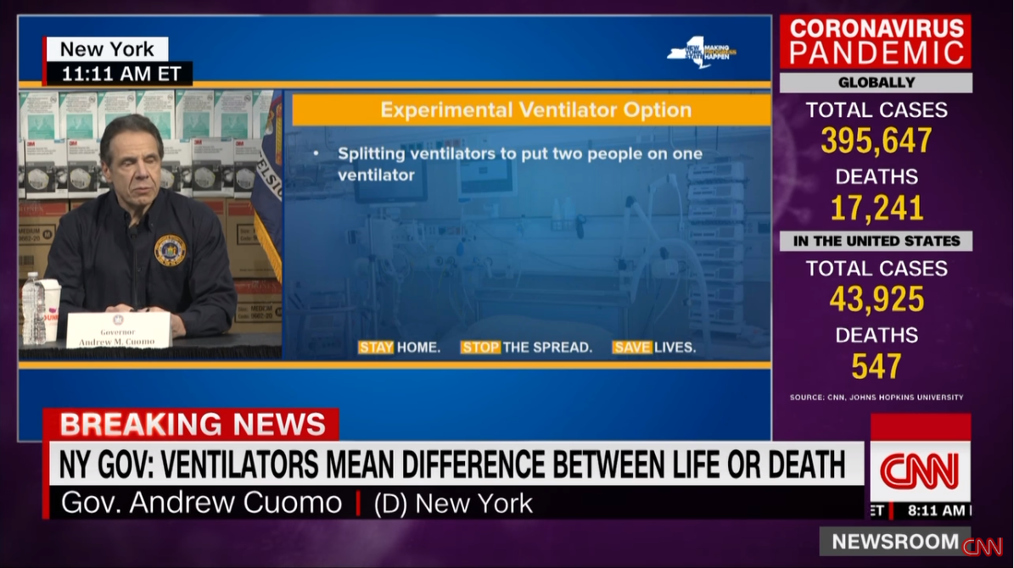
Ventilator Sharing
Discussed in media
Utilize ventilators in the community
Experimental therapy

Slide 34
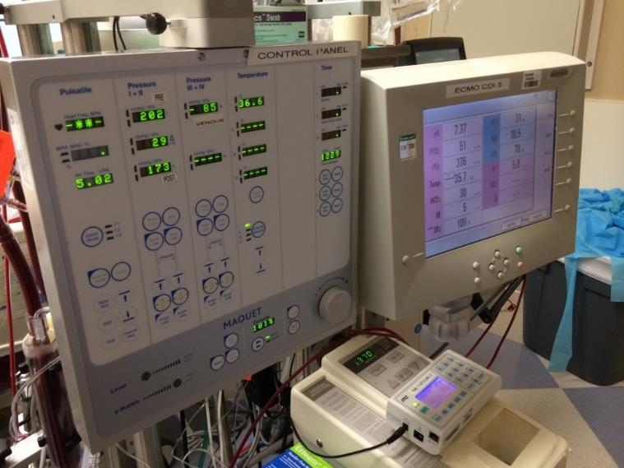
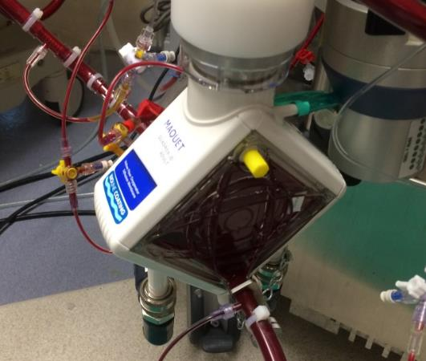
ECMO
Overseas centers…
New vs Existing programs
Local decision making
E-CPR

Slide 35
Cardiovascular
Norepinephrine first line
MAP goal 60-65mmHg ideally
Be aware of preload, monitor right heart if possible
Endocrine
Steroids (Hydrocortisone 200mg/day) for shock *if needed
Thyroid

Slide 36
Renal/Fluids
Conservative Fluid Strategy
Crystalloids vs Colloids
Balanced crystalloids vs unbalanced crystalloids
15% AKI → early diuresis and/or CRRT
Follow the systems
Prophylaxis, nutrition, antibiotics

Slide 37
Prepare Yourself
Observe rounding
Site specific planning
ASA Resources: CAESAR ICU
Respiratory/Pulmonary available today… others tomorrow

Slide 38
Summary
Don’t become a victim
Early aggressive intervention
Leverage the team and ask for help

Slide 39
Meet the Team!
Raquel Bartz, MD
Suzanne Bennett, MD
Samuel Galvagno, DO, PhD, FCCM
Kristina Goff, MD
Craig Jabaley, MD (Co-Chair)
Ashish Khanna, MD
Meghan Lane-Fall, MD
Michael Nurok, MD
Shahla Siddiqui, MD
Roshni Sreedharan, MD
Jared Staab, MD
David Stahl, MD
Ricardo Verdiner, MD
Physicians in Bergamo, Italy
Education Team:
Susan Carlson (ASA)
Vjekoslav Hlede (ASA)
Gerry Higgins (ASA)
Janet Thron (SCCM)

Slide 40
Clinical Experiences…
ASA Committee on Critical Care Medicine
Sara Auld, MD
Will Bender, MD
Neal Cohen, MD
Lisa Daniels, MD
Margit Kaufman, MD
Vivek Moitra, MD
Robert Loeb, MD
Peter Papadakos, MD

Slide 41
Thank You and Be Well
Your participation in this webinar enables you to claim CME credits at www.asahq.org/covid19cme0326
Replay will also available. Please tell your colleagues who weren't able to participate tonight.
Additional and ongoing COVID-19 resources at www.asahq.org/covid19info
asahq.org | apsf.org
Notes:
DR. PETERSON CLOSING REMARKS
CME is available
Replay will be available within 48 hours
We are truly all in this together...
Thank you so much for the work you are doing...

