Slide 1
Special ASA/ACHE Joint Webinar - Challenges and Strategies in Restarting and Expanding Elective Surgery after COVID-19
May 7, 2020

Slide 2
Housekeeping
For this broadcast, your camera and microphone have been disabled. We encourage you to interact with other participants in the Chat, located at the bottom of the broadcast window.
Submit questions to the panel using the Q&A box at the bottom of the broadcast window, not through the Chat.
If you have technical issues, please close your browser and restart the webinar – or perhaps move closer to your router.
We are recording this broadcast today and will be adding the full video to the ASA website to view on demand or share with your colleagues within the next 24-48 hours.

Slide 3
Disclaimer
As a reminder, the items we discuss today are provided for informational purposes only and do not constitute medical or legal advice. As always, you should consult with your own medical and legal counsel.

Slide 4
Learning Objectives
At the end of this activity, learners will be able to:
Evaluate the necessity of elective surgery based on clinical needs and prioritize procedural patient/case care.
Discuss recommendations on testing patients and staff prior to resuming elective surgery.
Summarize public health information and, in collaboration with state public health authorities, prioritize PPE use for non-elective surgeries.
List self-care practices to implement in your practice after activity.
Set timeline and administrative expectations to resume elective surgery.

Slide 5
Welcome, Anesthesiology Community and Healthcare Leaders
Anesthesia Care Team: Anesthesiologists, Anesthesiologist Assistants, Nurse Anesthetists, Anesthesia Techs, Anesthesia Administrators and Executives
American Society of Anesthesiologists
American College of Healthcare Executives
Anesthesia Patient Safety Foundation
Society of Critical Care Anesthesiologists
Society of Critical Care Medicine
Hospital and health system leaders

Slide 6

Panel Participants

Slide 7
How Do We Prioritize Patients?
How Do We Reassure Their Families?
Harry C. Sax, MD, FACS, FACHE
Vice Chair, Surgery; Executive Vice Chair, Dept of Surgery Administration; Professor, Surgery Cedars Sinai

Slide 8
Disclosures
I have no relevant disclosures or conflicts of interest.

Slide 9
Restoring Elective Surgery
Who goes first?
How quickly do we ramp up? How quickly can we pull back?
How do we assure safety for the operative team and patient?
What if they don’t want to come to the hospital?

Slide 10

Today’s words of Wisdom

Slide 11
Surgical Services since mid-March
Turning off the tap
Created twice weekly review by surgery, anesthesia and peri-operative leadership of all cases and determined urgent/emergent cases
Postponed >1500 surgical cases, including oncology, (70% outpatients)
OR staff has had specialized in-services for patients COVID cases
Pre-op screening capacity increased from 10 to >70 per day
Began to see postponed patients coming back with worsening symptoms
Titrated scheduling as COVID curve became more predictable
Notes:
Sax

Slide 12
Magnitude of the decrease – over 1600 cases
    Daily Average Current Average
    Surgical Services 120 per day 25 per day
    Cardiac Cath Lab 35-45 per day 8-10 per day
    Interventional Radiology 19 per day 10 per day
    Procedure Center 30 per day 30 per day
    GI Lab 45 per day 15 per day
    Imaging 11-12 per day 3-4 per day
Notes:
Sax

Slide 13
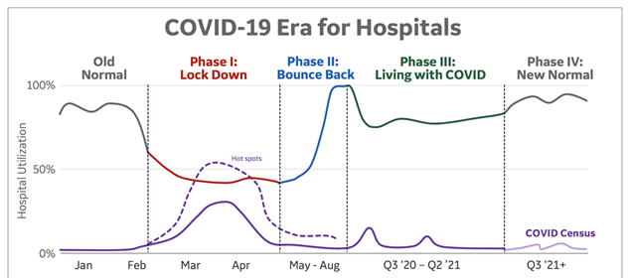
Our path forward…
GE Healthcare 4-2020

Slide 14
Reopening access
Determine ambulatory and inpatient capacity
Try to create COVID free zones
Decide if you can COVID screen all your procedures
Centralize both screening and preoperative assessment
Prioritize postponed cases, especially oncology, cardiac and transplant
Have guardrails should volumes ramp up rapidly

Slide 15
Compartmentalize deferrals-and new cases
Cohort ambulatory procedures in COVID free area
Postponed lists sent to each service line
Asked to organize by inpatient /outpatient
Time sensitivity - <4 weeks, 4-8 weeks, >8 weeks
Cases are placed based on urgency, and inpatient capacity
Utilize ASCs and encourage surgeons to have inpatient cases days separate from outpatient
Individual blocks will not exist for the next 8-12 months, but service line blocks will

Slide 16

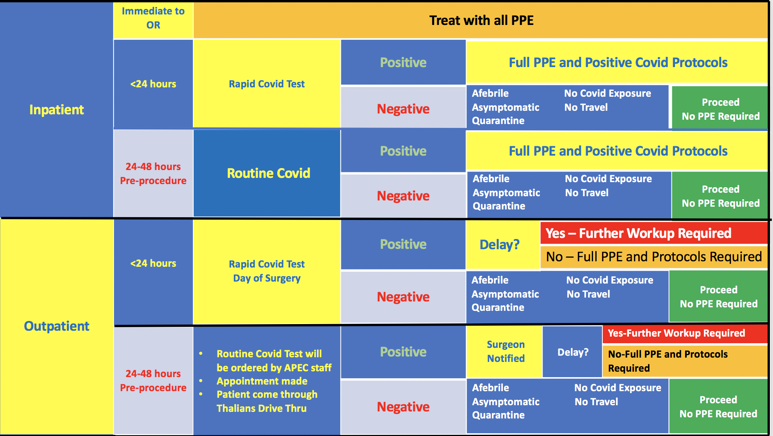
CSMC COVID-19 OR Screening Protocols
Afebrile
Asymptomatic
Quarantine
No COVID Exposure
No Travel
Unanticipated positive screen <1% (Los Angeles)
Now screening all ED admissions
Notes:
Blaha/Grant

Slide 17

But Will They Come Back?

Slide 18
Reassuring Patients and Families
The message may be better from County Health Departments about not delaying needed care
Individual hospitals should highlight their employee screening process (temperature and symptom check, universal masking)
Use social media from patients who returned to get their care
Within reason, liberalize visitor restrictions – one visitor authorized throughout the hospitalization, with daily screening and required to mask
At this point, routine COVID testing is not indicated for asymptomatic employees.

Slide 19
Restoring Elective Surgery
Who goes first?
How quickly do we ramp up? How quickly can we pull back?
How do we assure safety for the operative team and patient?
What if they don’t want to come to the hospital?

Slide 20



Slide 22
Considerations: Workforce and Testing
Robyn Begley, DNP, RN
American Organization for Nursing Leadership CEO
American Hospital Association, SVP, Chief Nursing Officer

Slide 23
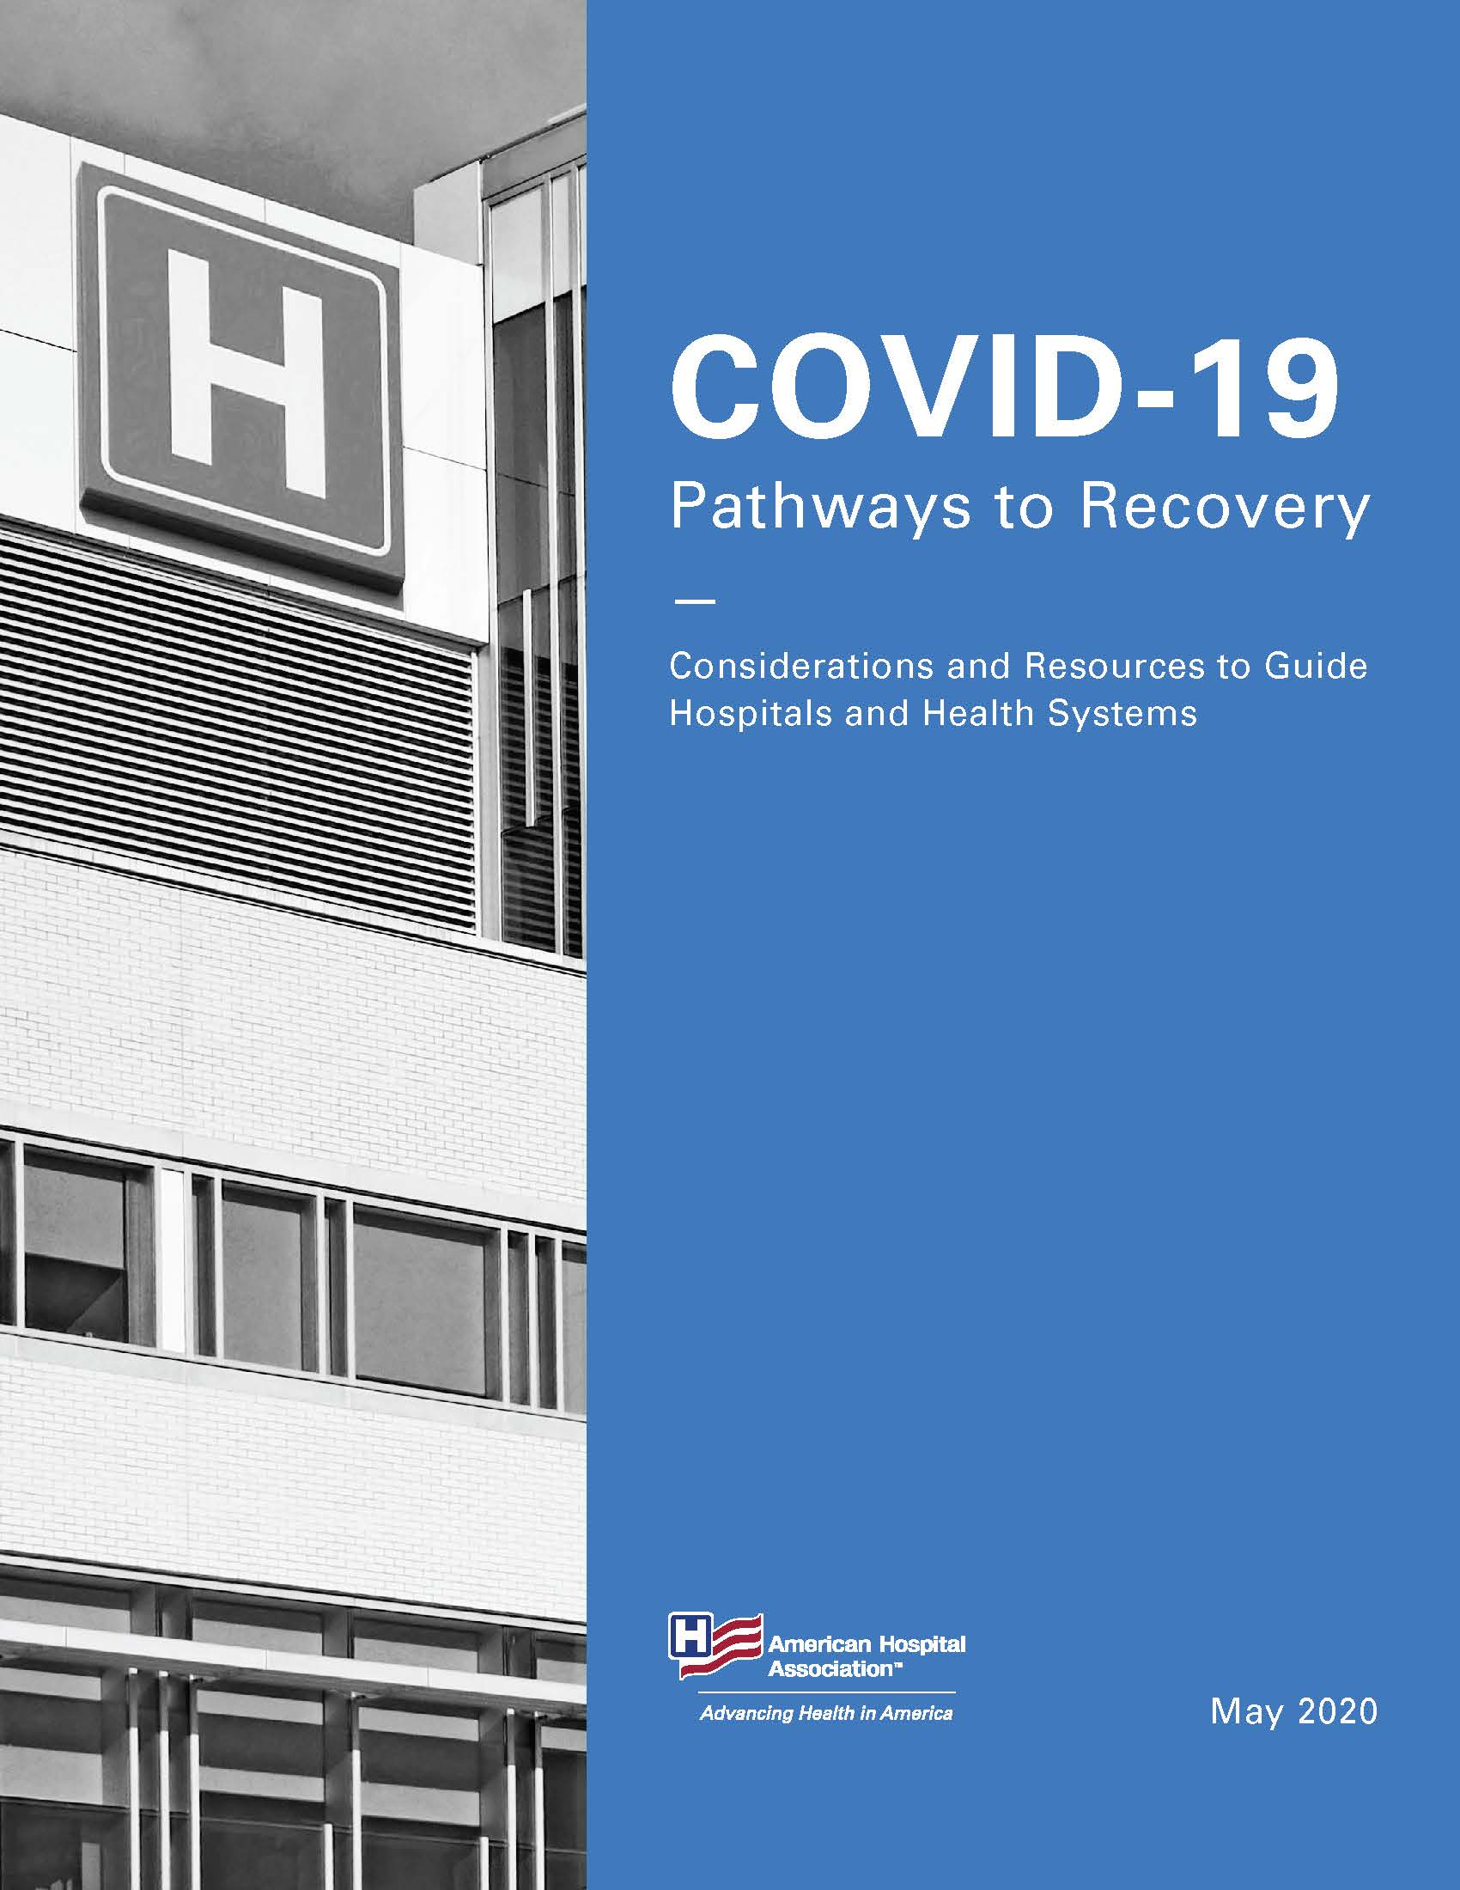
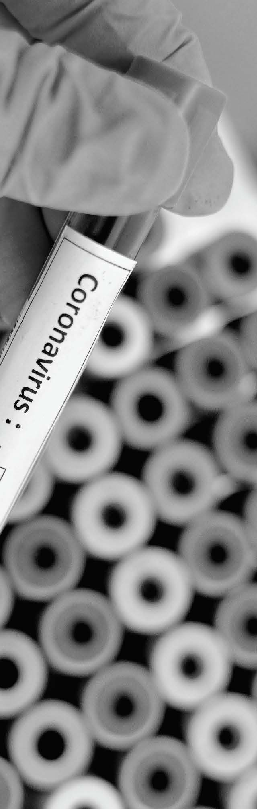

Slide 24
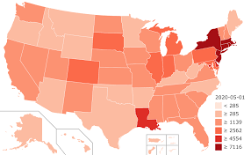
Workforce Considerations
Hot Spots vs. Less Effected Areas
Notes:
Issues vary between COVID hot spots and areas less effected where hospitals had reduced patient volumes due to cancellation of elected surgeries

Slide 25

Staffing
Bringing back furloughed workers
Planning for vacations and federal paid leave for child care
Assigning staff to specifically care for COVID-19 patients
Handling COVID-positive staff with mild or no symptoms
Returning to pre-waiver provider scope of practice regulations
Establishing threshold for returning to pre-COVID-19 pay practices

Slide 26

Resiliency & Burnout
Encouraging bedside staff to identify lessons learned/best practices
Incorporating new leadership models
Celebrating accomplishments and recognizing loss
Communicating transparently
Enhancing employee trust and loyalty
Encouraging time off

Slide 27
Education and Training
Evaluating current training offerings in light of technology and testing protocols
Waiving or delaying annual performance assessment
Reinstating clinical rotations and internships
Training clinicians to work in critical-care units

Slide 28

Testing and Contact Tracing Considerations
Planning
Procedures
Data collection and infrastructure
Surveillance
Photo by CDC on Unsplash

Slide 29
Planning
Coordinating with public health departments, community groups, federal agencies
Defining roles and resources
Identifying, supplying and staffing testing sites
Applying testing algorithms and protocols
Monitoring of state and local testing guidelines

Slide 30
Workforce Testing Procedures
Identifying timing/intervals for staff testing
Defining process for maintaining awareness worker infection status
Identifying who will test first responders entering your facility
Identifying policies on testing and guidance for refusal of testing
Educating and training staff on testing protocols and plans
Documenting staff testing

Slide 31

Data Collection and Infrastructure
Collecting data and submitting across sites of care
Analyzing data and defining reporting modules
Ensuring data collection is secure

Slide 32
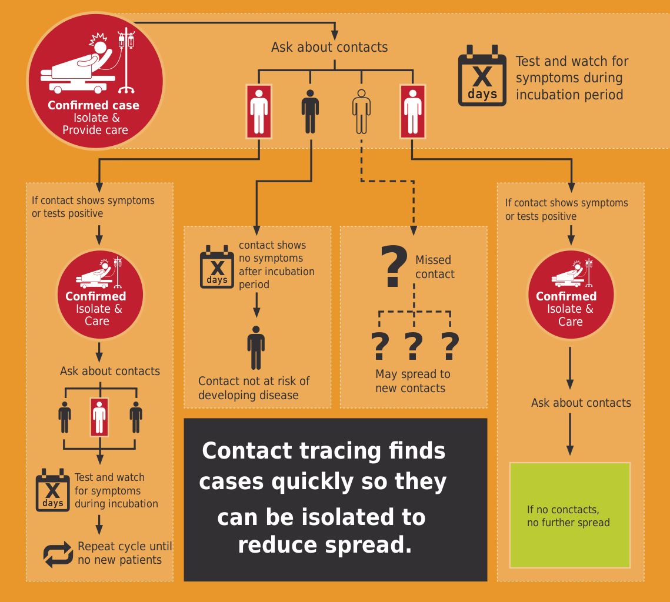
Surveillance and Contact Tracing
Defining surveillance, including use of serial testing
Establishing procedure for tracing and documenting hospital-acquired COVID-19 infections/staff infections
Considering community connections to supplement tracing resources
Investigating and identifying tools for monitoring home-quarantined people
Photo from Wikimedia Commons

Slide 33
Considerations for Resuming
Non-Emergent Surgery
Mary Dale Peterson, MD, MSHCA, FASA, FACHE
President, American Society of Anesthesiologists

Slide 34


Considerations for Resuming
Non-Emergent Surgery

Slide 35
Timing
Sustained reductions in the rate of new COVID cases for 14 days
Authorized by appropriate municipal, county and state authorities
Appropriate hospital capacity without resorting to crisis standards of care- this includes beds, PPE, ventilators, drugs and supplies
Surgeons working with anesthesiologists and OR staff need to determine which patients go first from the backlog

Slide 36
Patient Testing
“Roadmap for Resuming Elective Surgery after COVID-19 Pandemic”
  Facilities should use available testing to protect staff and patient safety whenever possible
  Facilities should implement a policy addressing requirements and frequency for patient and staff testing.
  Facilities should account for:
    Availability, accuracy and current evidence of testing
    Frequency and timing of patients
    If no testing is available, use evidence-based infection prevention techniques
  Clear policies on how to respond to positive workers, positive patients, PUI HCW and PUI patient

Slide 37
Patient Testing
ASA/APSF Joint Statement on Perioperative Testing for COVID-19 Virus
  Patients should be screened for symptoms prior to presenting in hospital
  All patients should receive a nucleic acid amplification test (including PCR tests) prior to non-emergent surgery
  Mitigate false-negative tests
  If a patient tests positive for SARS-CoV-2, elective surgical procedures should be delayed until the patient is no longer infectious and has demonstrated recovery from COVID-19.
  Policy should contemplate CDC test-based and non-test-based strategies
  Evaluation of sufficient recovery by a patient should include an assessment of the patient’s exercise capacity (metabolic equivalents or METS).
  Antibodies develop in the second week of symptoms and not all patients who are infected with SARS-CoV-2 develop detectable antibodies. Antibody testing should not be used for preoperative screening."
Notes:
Screening and testing to detect SARS-CoV-2 is essential for the safety of patients, HCWs and the general public.

Slide 38
PPE- Personal Protective Equipment
Regardless of screening and testing, appropriate PPE (masks, eye protection, gown, gloves) should be worn for all patients
Aerosol Generating Procedures (AGPs) require N95 masks or equivalent and eye protection (face shields/goggles)
  Intubation, Extubation
  Bag Mask Ventilation
  Bronchoscopy
  Electrocautery of blood, GI tissue
  Laparoscopy/endoscopy
  ENT procedures

Slide 39
PPE – Personal Protective Equipment
High Risk – if the patient has active COVID, influenza-like symptoms, or PUI
Low Risk – Patient asymptomatic and untested or COVID negative in 48-72 hrs. prior to surgery
Single use N95 or PAPR, eye protection used, gown, double gloves
N95 mask and eye protection that can be reused, gown, double gloves

Slide 40
PPE – Personal Protective Equipment
Powered air-purifying respirators (PAPRs)
  Depending on air flow setting, the use of a PAPR may reduce the risk of exposure to HCW
  Experts are unclear on the effect PAPRs have on the sterile field because PAPRs do not filter discharged air
    One abstract from American Journal of Infection Control showed no differences in particulate counts at the surgical table whether the PAPR was turned on or off
  Cumbersome to use: Can limit visibility if they fog up, unable to use a headlight, hearing may be impaired, dry eyes
  Preferable for those who fail N95 fit test or very high-risk procedures (basal skull surgery in COVID patient)

Slide 41
Reuse/Decontamination of N95s
Issue 5 respirators to HCWs and paper bags for storage and rotate use with minimum 5 days between use (write on strap, not respirator)
Ultraviolet germicidal irradiation
Vaporous hydrogen peroxide (e.g. STERRAD)
Moist heat
* Need to instruct HCWs regarding “seal check” (feeling leakage of air)

Slide 42
Sites of Care
Patient flow considerations – screening, holding areas, PACUs, check-in, waiting areas
Staggered starts
Skipping Phase 1 recovery where possible
Regional techniques where possible
Ambulatory Surgical Centers
Non-Operating Room Anesthetics – MRI, cath lab, etc.

Slide 43
Returning to the “new normal”
Enhanced infection control
Adjusted workflow
Potential for increased turnover times
Need for everyone to recognize the additional challenges in the new environment – surgeons, anesthesiologists, nurses, administration
We can provide a safe environment for HCWs and patients but efficiency will be diminished

Slide 44
Crafting a Better Normal
Alan S. Kaplan, MD, MMM, FACPE, FACHE
Chief Executive Officer, UW Health

Slide 45





Transitioning from Tactical to Strategic
Capability Development
Damage Mitigation
Mission Recovery
Crafting a Better Normal
Preparedness and Activation

Slide 46
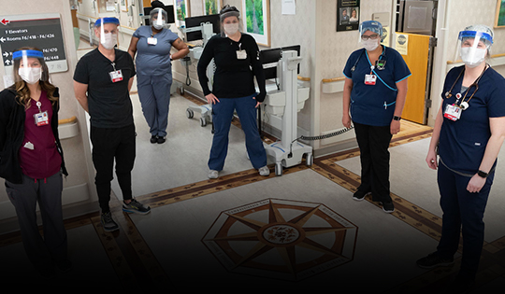
COVID-19: Testing Hospital Cultures
#1 Priority: caring for clinical teams so
they can care for our patients
Proving we can pivot and adapt quickly
Tremendous collaboration:
hospitals, providers & staff, government, university and community
Everyone is traumatized—hot spots or not

Slide 47

Managing the Lingering Pandemic
We have dealt with infections within our walls since the inception of hospitals and never closed down. Why should this be different?
Going forward:
  Better understanding of COVID-19
  Policies & procedures for patients,
  staff, visitors
  Testing capabilities
  PPE supply
  Innovations such as intubation box,
  promising treatments (e.g., Remdesivir)
  New behavioral norms

Slide 48

Viewing Reality with Candor
Loss of efficiency
Financial setbacks
Regulatory relief
Work-at-home
Virtual meetings
New care models
Flexible facilities
Telehealth on steroids

Slide 49

Thinking Differently About Telehealth
No reimbursement
Regulations
State licensure
Patient satisfier
Outreach
Less reimbursement
Provider satisfaction
Surgical conversion rates
Staffing shortage relief
Service line resizing
Facility downsizing
Retail pharmacy
Value-based care
Old School
New School

Slide 50

Returning to “Normal”—A Strategic Blunder
A single strand of RNA has proven to have more power to rapidly change the healthcare industry than thousands of innovators & billions of private equity dollars
Financial stressors will provide a
sustained platform for change
There is a hunger in Washington,
D.C. and among hospital leaders for
regulatory relief, but the window of
opportunity may be open briefly
The new disruptive innovator will likely
be your direct competitor!

Slide 51
Thank You and Be Well
Your participation in this webinar enables you to claim CME credits at www.asahq.org/covid19cme.
Replay and slides will be available at www.asahq.org/townhalls within 24 hours. Please share with your colleagues who weren't able to participate tonight.
Additional ASA and ongoing COVID-19 resources at www.asahq.org/covid19info.
Additional ACHE and ongoing COVID-19 resources at https://www.ache.org/about-ache/resources-and-links/covid-19-resource-center.
Notes:
DR. PETERSON CLOSING REMARKS
CME is available
Replay will be available within 48 hours
We are truly all in this together...
Thank you so much for the work you are doing...

